Slide 1
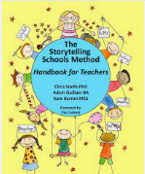

Storytelling at
Repton Manor Primary School

Slide 2
What are we great at?
☺
Model texts
Differentiation
Links to other curriculum areas
Story map confidence
Range of genres
Additional support – word mats, checklists
Recycling ideas

Slide 3
What will we work on developing this year?
Recap the structure (+support anyone new to Storytelling at Repton)
‘Performance’, awe and wonder!
Deepening activities
Non-fiction links and opportunities within stories (multiple story uses)
Increasing the purpose of our published pieces
OUR AIM: for every child to re-tell a story completely by heart at the end of the year!

Slide 4
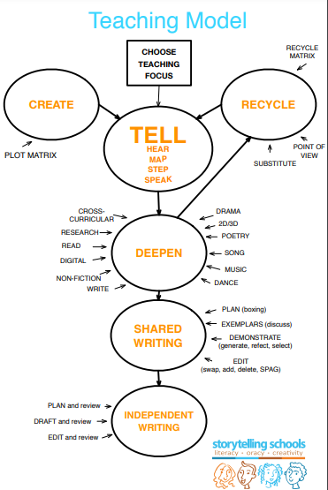
The Storytelling Teaching Model
Play to the audience with ‘tell’. How will you capture them all? How will you set the scene? How do they children know it’s story telling time?
‘Map’ between 8-12 pictures – Chris Smith recommends no more than this or they lose ability to do it themselves and add their own ‘voice’ to it.
How can you help them ‘step’ and ‘speak’ it? The ultimate goal is they can do it without the map!

Slide 5
How can we get the ‘awe’?
Identify your next story and plan the wow factor.
Atmosphere: Music? Lights? |  | Performance: Costume? Voices? You or someone else?
Learning focus: (3max) + toolkit | Story:
 | Deepening activities:

Slide 6
Atmosphere: |  | Performance:
Learning focus: | Story:
 | Deepening activities:

Slide 7
Atmosphere: |  | Performance:
ELG focus: | EYFS story:
 | Provision activities:

Slide 8
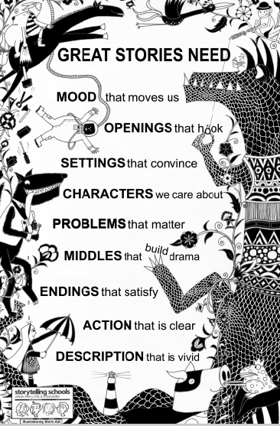
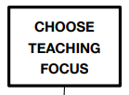
What do ‘great stories need’?
Refine our purpose by choosing a learning focus for a narrative piece.
Decide whether you are writing a start, a middle, an ending or the whole story – do what suits your cohort and their needs!
Explore the 9 story building blocks from page 22 of the Method handbook and identify the toolkit.
Keep this at the forefront of story creation to really refine what we are asking of the children.

Slide 9
Use pg22-25* to help identify what the learning focus will be for your next story. *Further notes on page 27
Atmosphere: |  | Performance:
Learning focus: (3max) + toolkit | Story:
 | Deepening activities:

Slide 10
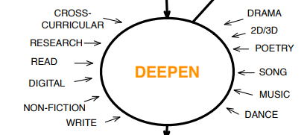
Deepening activities
- at least 3
Deepening should be where the children apply the language and content of the story in a variety of creative ways.
It should expand their vocabulary, deepen their imaginations and continue a lively style of learning as from the ‘Tell’ stage.
It should develop ideas and content to enable them to write more effectively at the writing stage.

Slide 11
Let’s take a familiar story: Little Red Riding Hood
From the middle of the story:
Inside the forest, she began to worry. There was a rustling sound and a howling noise and she imagined all sort of creatures hiding and watching her.
In the forest, what would LRRH hear, see, think and feel. Fill with words/phrases.
HEAR | SEE
THINK | FEEL

Slide 12
Poetry creation – 3434 (words per line)
HEAR Leaves rustle, creaking branches, howling noise, | SEE Towering tall trees, eyes glistening, animal tails,
THINK I wonder if there’s anything here, What if something gets me, | FEEL frightened, afraid, nervous, cold, shaky, shivering
Rustle! Creak! Howl!
I see eyes glistening
Is anything here?
Nervous. Cold. Shaking.
Put it to the tune of Twinkle, Twinkle, Little Star and you have a mini song!

Slide 13
Role play in character
Pick an emotion or characteristic of one particular character
eg: angry and impatient (the wolf’s perspective).
Complete the grid then act in role or freeze frame in role.
Speech “I’ve got a plan to catch that silly girl” “She’ll never notice me here” | Thought I’ll get her, She’s done for,
Appearance Gnarling teeth, red face, glaring eyes, sweaty | Action Stamp feet, clench fists,
ANGRY & IMPATIENT

Slide 14
Character deepening:
Hot seat using specific words and from picking a point in the story.
Ask the character ‘What did you …say, do, think, feel’
Phone home – a key character calls a parent and explains what is happening, and how they feel, from their perspective. Also try from ‘secondary’ characters. (Past tense)
Make a ‘inside/outside’ poster – life size, to represent feelings and actions – all can contribute.
Hold a press conference for different characters.
Diary/Social media entries
Puppet show for re-enactment
Speech bubbles

Slide 15
Extra deepening:
Plot matrix – this can deepen the understanding of a more complex story, especially for KS2. pg58/59
Mood map – plot for a useful way to see the emotional range of the story and guide recycling/replication. pg61
Variety of poem types pg63-68
Song/Movement/Dance
Object or setting study – can you bring an object in for them to study or take them to a setting?
Non-Fiction links – we will study in another section!

Slide 16
Deepening activities
- at least 3
KEY POINTS FOR DEEPENING:
Keep it relevant to your purpose/learning focus
eg: if you have chosen to create characters that we care about, role play which considers: action, speech, thought and appearance will be crucial.
If you have chosen to make a middle that builds drama, a poem or song of a particular picture or section on the story map will be crucial.
*Add actions/gestures as much as possible to help support their story recall.

Slide 17
Choose at least 3 deepening activities to go with your next story – use the yellow book to help too.
Atmosphere: |  | Performance:
Learning focus: | Story:
 | Deepening activities:

