Slide 1
PE Staff Meeting
28th February 2024

Slide 2
You have 1 minute to write down as many sports/games as you can.
How would you organise the sports/games that you have written down?
What are the key skills for people to be successful in each of the groups of sports that you have written down?
Hopefully, you will have noticed that, despite the sport, there are a number of different skills which need to be mastered in order for people to be successful!

Slide 3
Aims:
Share aims and values for PE within our school
Understand Pillars of Progression in PE
Introduce new LTP and scheme
Develop PE pedagogy and confidence to teach PE

Slide 4
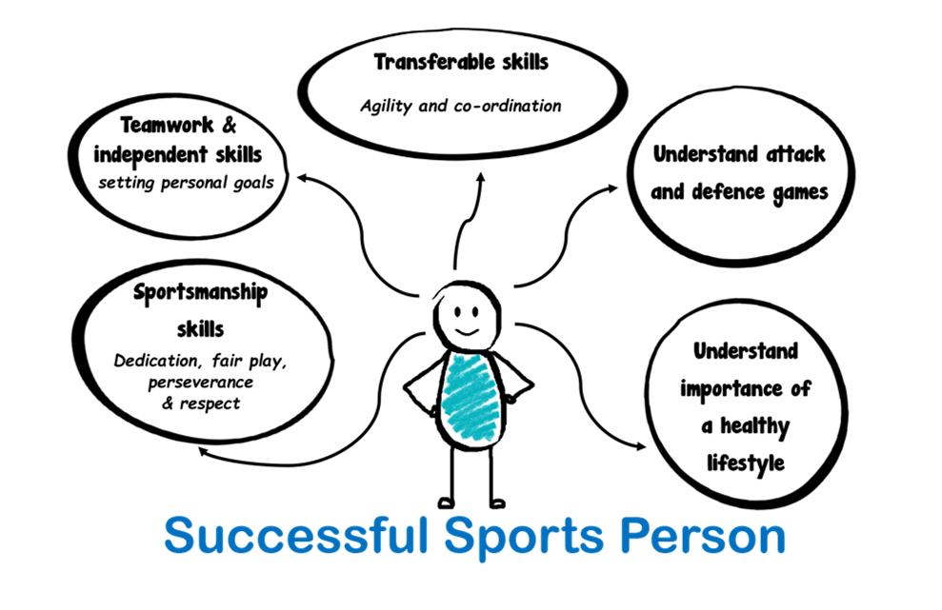
Our Vision
Our VISION is to inspire EVERY child to be passionate about Physical Education and Sport, while bringing PE to the heart of the school.
To equip every child with the key physical and social skills that can be facilitated through to PE and sport.
To enable every child to progress with confidence and competence in PE and sport -throughout their school journey and beyond.
To embed key sporting values that can be applied positively in everyday life.
To inspire children to live a healthy and active lifestyle into adulthood, using PE and sports to facilitate this.
To develop the physical and mental wellbeing of every child and ensure it is central to their physical education journey.

Slide 5
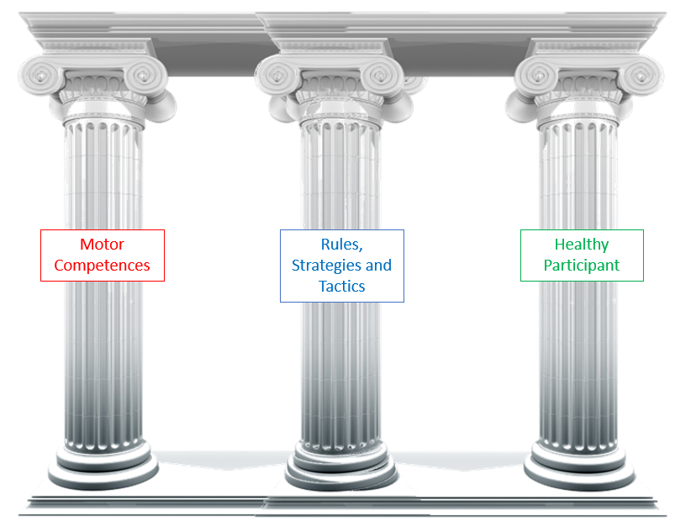
Pillars of Progression in PE
Motor competence
Rules, strategies and tactics
Healthy participation
This can be described as a person’s ability to execute a variety of motor actions, including the coordination of fine and gross motor skills.
These are necessary to participate in activities in everyday life, including play and physical activity.
Pupils need to be explicitly taught the knowledge that informs and successfully directs their movement, e.g. knowledge of rules, strategies and tactics.
PE plays an integral part in pupils leading healthy, active lives.

Slide 6
Pillars of Progression in PE
Motor competence
Pupils need to develop fundamental movement skills (FMS) in the early years. These are basic, learned motor patterns that do not occur naturally, and include:
locomotor skills, e.g. running and jumping;
stability skills, e.g. twisting and balancing;
manipulation skills, e.g. throwing and catching.
FMS are best developed between 3 and 8 years old; therefore, careful progression through reception and primary school is vitally important.
Research studies have shown competency differences between boys and girls, in primary school and beyond. Therefore, lessons must provide all pupils with the progressive, high-quality lessons required to develop their FMS.
Proficiency in FMS provides the building blocks for pupils to confidently and competently explore a greater range of movement; pupils without these are likely to struggle with more specialised movements.

Slide 7
Pillars of Progression in PE
Rules, strategies and tactics
Tactics during a game can be considered as decisions about how to move, when to move and where to move.
Tactical learning cannot easily be separated from motor competence, since a tactic is only successful if the participant can execute the movements involved.
Strategies and tactics should be taught within different contexts.
Healthy participation
PE plays a vital role in connecting important ideas about health to physical activity. It ensures that pupils explicitly learn the ways in which to prepare for safe and effective participation in different activities, or for different fitness demands.
Disconnected facts and ideas can make it difficult for pupils to make important informed decisions about their own healthy participation.

Slide 8
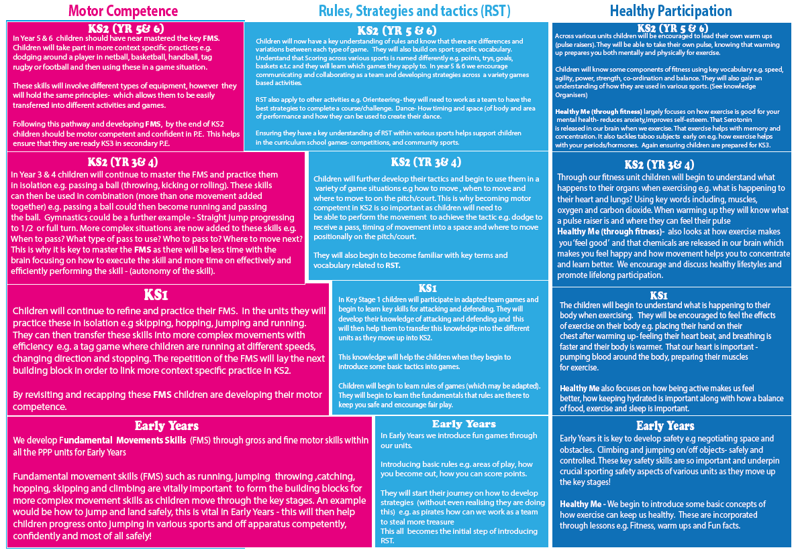

Slide 9
Pedagogy – Curriculum Implementation
Some key concepts:
Pupils follow a curriculum that is similar in breadth and ambition to the national curriculum.
Teachers and leaders recognise that learning takes time and ensure that pupils have opportunities to revisit and develop their knowledge within a context, before moving on to a new sport or physical activity.
The curriculum sequence competently supports pupils to connect the steps in the PE curriculum.
Leaders who plan the curriculum understand the importance of the sport or physical activity taught.
Curriculum progression is evident, e.g. activities require pupils to recall prior knowledge, seek similarities and contrast the different contexts.
Physical activities and sports are selected based on capacity to develop pupils’ competence within PE, using the three pillars to help identify key concepts to teach and building pupils’ understanding incrementally
The extracurricular offer is available for all pupils. It provides opportunities to build and refine knowledge, and has a symbiotic relationship with curriculum PE.
The PE curriculum meets the needs of all pupils. All pupils feel included and able to succeed within the subject.

Slide 10
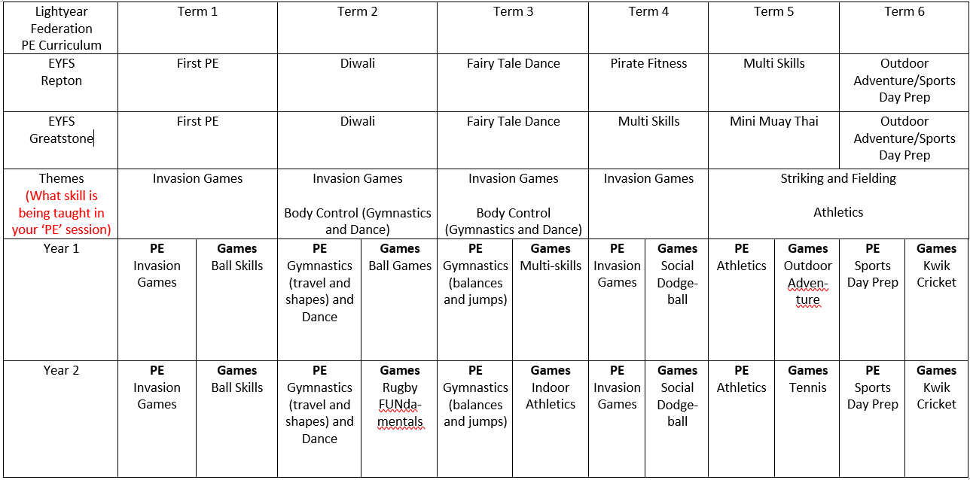
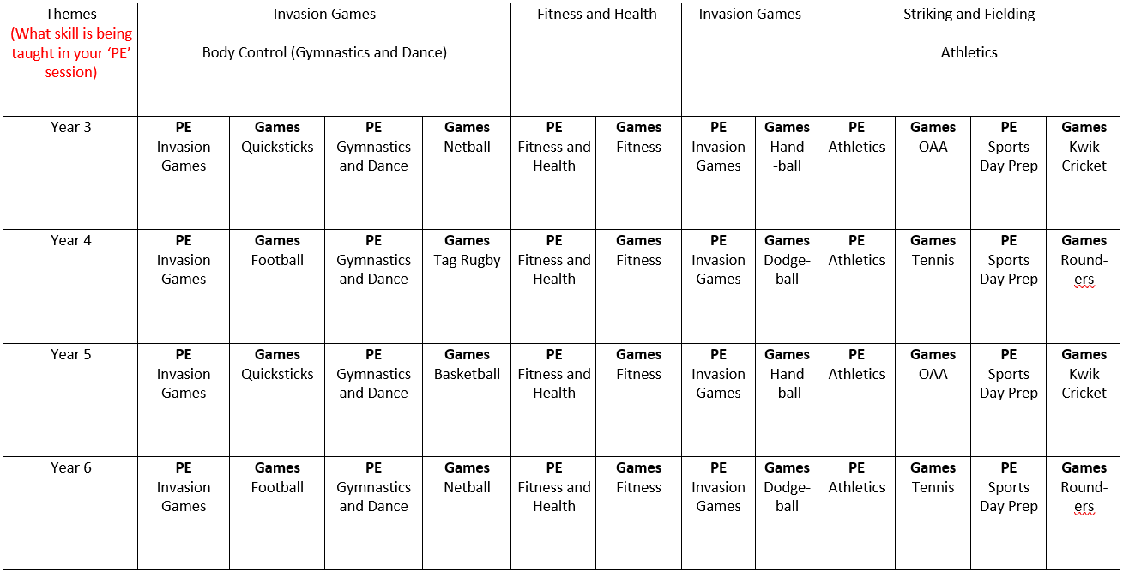
Repton’s new PE Long Term Plan
Rationale:
Organised into themes
Units broken down into two parts:
1) Physical Education (PE)
2) Games
Physical Education should provide teachers with the flexibility to teach skills that children need more practise with using different contexts.
Move away from schemes to develop staff’s confidence and repertoire to teach different elements of PE.
Use assessment to inform planning for next PE unit.

Slide 11
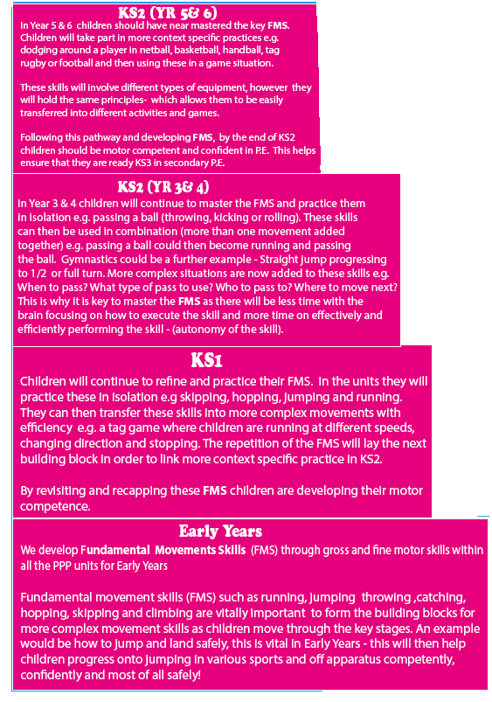
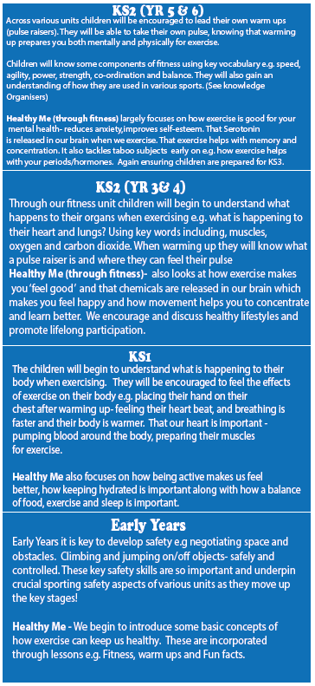
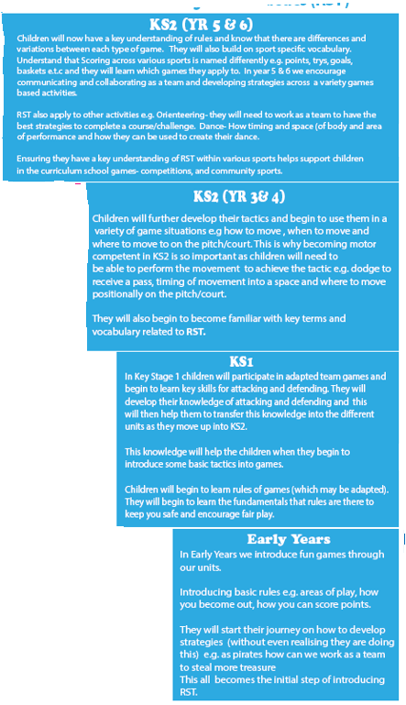
P.E. or Games?

Slide 12
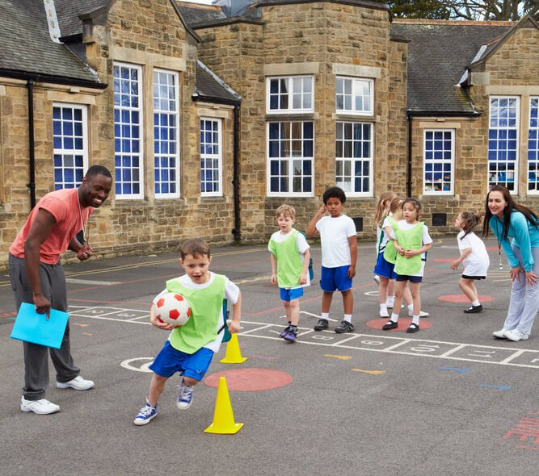
It will be up to teachers and Keir to decide which element they would like to teach – PE or Games.
Usually, it will be Keir teaching the PE (skill) elements, but it doesn’t have to be depending on the unit.
All Games units and some PE units are on the new Primary PE Planning Website.
If you are teaching a PE element, then we have created a skills breakdown document to support your planning (there may also be supportive ideas or planning on the website).

Slide 13
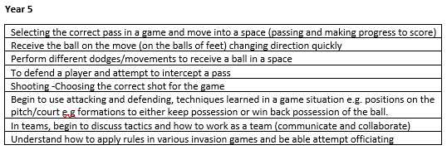
“Skill breakdown is breaking down the two or more components that execute a skill, in some cases you may need to look at the supporting skills that assist with execution of the desired skill.” Such as evade and then the kick.
Example of the breakdown of skills from the Invasion Games unit.

Slide 14
New PE planning website!
www.primarypeplanning.com
Username: robsonc@greatstoneschool.co.uk
Password: crpe

Slide 15
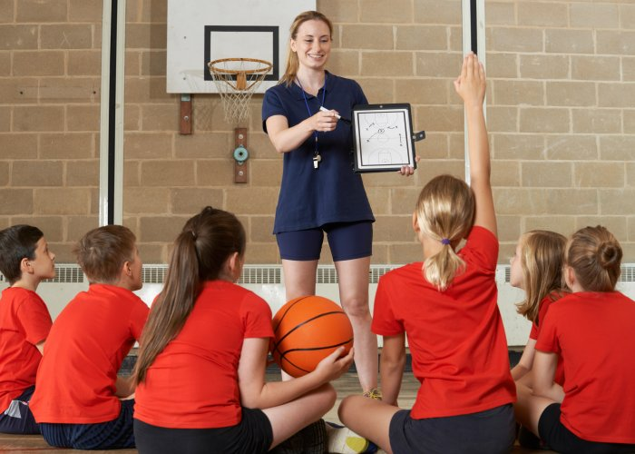
Pedagogy in PE
Or……
How to teach a good PE lesson!

Slide 16
Pedagogy – Belief, Demonstration and Feedback
Some key concepts include:
It is important that pupils do not see their attainment as fixed. Feedback that pupils receive within lessons should enable them to develop their competency and empower them to feel that they can improve.
Modelling and demonstrations can provide pupils with clear visuals of motor patterns, in order for them to imitate and to compare with their own actions, allowing them to practise, receive feedback and improve.
Practice should be sequential; they should be structured, from simple to complex, giving pupils sufficient time to practise precisely and with increasing independence.
Not all practice is effective; teachers need to carefully monitor practice, making adjustments to practice situations that provide additional support or challenge where required.

Slide 17
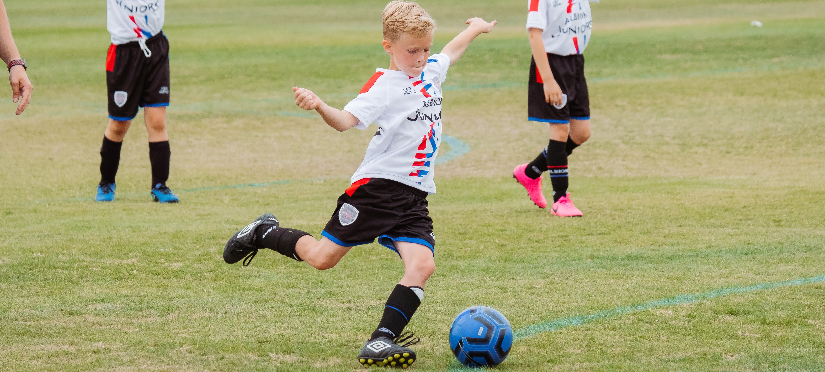
Pedagogy – Time Spent Being Physically Active in PE
Some key concepts include:
The Association for PE recommends that pupils actively move for 50% to 80% of the available learning time, although research shows that, on average, this is currently 40%.
Some activities lend themselves to higher levels of physical activity, such as fitness, invasion games and track athletics. Other activities can be more physically active if practices are set up effectively and there is less time spent on transitioning between activities or waiting to participate.
When pupils are spending short periods not being physically active, they should be benefiting from an activity that supports the intended curriculum goal, for example, giving structured feedback to active participants.

Slide 18
Now over to Keir to show us what a good one looks like…

