Slide 1

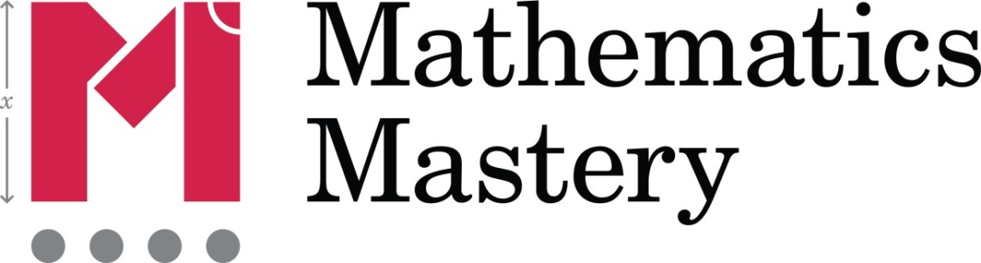
Session 1 Introduction

Slide 2

Aims of session 1
To gain an understanding of Maths Mastery classroom practice
To understand the Mathematics Mastery key principles
Notes:
Time: 1 minute
Purpose: Overview
Facilitation: Welcome colleagues to the session and the SKEW programme and explain the structure of the course. Explain that this introductory session will build on the initial training and focus on how the Mathematics Mastery key principles inform how we teach mathematics, and will include examples of activities used both in Mathematics Mastery lessons and at the teacher’s own level. There will be lots of mathematics to do, always thinking about and discussing how this will work in the classroom.

Slide 3
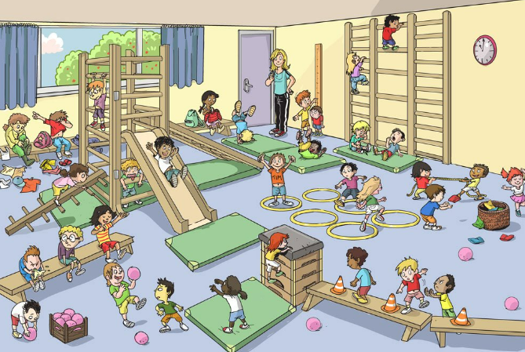
Starter – What Maths do you see?

Slide 4
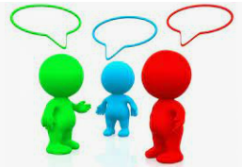
What is Maths Mastery?
What are the features of Maths Mastery?
How does this look within a class lesson?

Slide 5
What is Maths Mastery?
Mathematics mastery means:
Procedural fluency and a deep understanding of maths concepts
Being fluent with the unfamiliar!
Deeper, longer-term security of understanding
Deeper learning within your year group’s objectives
Something that builds up over time
The ability to use and apply what you know
Teaching everything right the first time

Slide 6
Thomas Guskey’s
Six Principles of Mastery
Diagnostic pre-assessment with ‘pre-teaching’
High-quality, group-based initial instruction
Progress monitoring through regular formative assessment
High-quality corrective instruction
Second, parallel formative assessment
Enrichment or extension activities

Slide 7
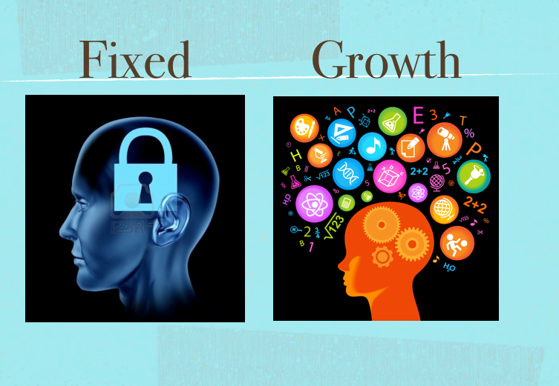
Mindset: fixed vs growth
Copyright (C) Mathematics Mastery 2017
Notes:
Time: 3 minutes
Purpose: Reflect on mindset
Facilitation: Explain one of the key aims of Mathematics Mastery is to increase pupil enjoyment and confidence in mathematics in order to help them to achieve success. This principle is the same for us as teachers working on this subject knowledge course. As MMSL, you may not have all the answers to all the questions colleagues may have about the learning and teaching of maths, but working together looking at and discussing key issues you will all be on a learning journey deepening your own knowledge, week by week. Remind colleagues about growth mindset (the belief we can all better if we apply enough effort) versus fixed mindset (the idea that you are “naturally good”, or bad, at something and that this cannot be changed). Discuss strategies for creating an environment that values challenge, risk and mistakes as well as the importance of process praise. How do we achieve this in our classrooms and in these sessions?
Lead into next slide: Let’s start with a Do Now activity

Slide 8
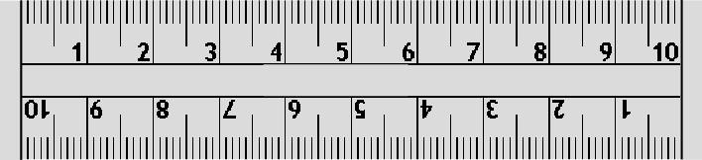
Do Now/Talk Task
What is a number?
Notes:
Time: 5 minutes
Purpose: What is number?
Facilitation: Remind colleagues that Mathematics Mastery lessons all start with a “Do now” to get pupils engaged right from the start and here’s one for them! Explain also that it’s a “talk task” and the idea is to get discussion going. Allow 2 – 3 minutes for this and then take feedback.
Prompts (if needed) – What types of numbers are there? What’s the difference between the numbers on a ruler than counting numbers?
Leads into next slide: Feedback prompts

Slide 9
‘What is a number?’ feedback
Continuous
Numeral
Number
Finite
Set
Discrete
Count
Infinite
Quantity
Compare
Magnitude
Notes:
Time: 5 minutes
Purpose: Feedback on discussion about number
Facilitation: Take feedback from the previous activity. Were any of these words used in your discussion? Are any of the words here unfamiliar? Do they help to clarify the differences between types of number?
Definitions:
Continuous: no gaps within a number line. ‘Zoom in’ and you will always find a value between two other numbers. E.g. Height – if someone goes from x tall to y tall they have gone through every possible height in-between
Discrete: separate and distinct. Specific values only. E.g. given shoe sizes. Someone moves from one shoe size into the next, e.g. a size 6 to size 6.5, or size 4 to size 5.
Numeral: the symbol used to represent a number
Numbers: describe quantities or values
Finite: limited in size, has an end point. E.g. the number of hours in each day
Infinite: limitless or endless e.g. the idea you can always have one more
Set: a collection of items. Order has no significance
Counting number: a whole number from one to infinity
Quantity: an amount or number of something
Compare: note the similarity or dissimilarity between items
Magnitude: the relative size of an object
Leads into next slide: Key principles: conceptual understanding.

Slide 10
Key Principles
Conceptual understanding
Pupils deepen their understanding by representing concepts using objects and pictures, making connections between different representations and thinking about what different representations stress and ignore.
Conceptual understanding
Mathematical problem solving
Mathematical thinking
Language and communication
Notes:
Time: 2 minutes
Purpose: An overview of the key principles
Facilitation: This slide shows an overview of the Mathematics Mastery key principles. The lessons and professional development offered through the programme is all incorporate and revolve around these. Briefly read the headings of each one and explain that these will all be addressed throughout the rest of the session. The first to focus on is Conceptual understanding – read through this explanation fully.
Leads into next slide: Having a look at some abstract representations

Slide 11
๕
५
൫
੫
۵
৫
五
V
Notes:
Time: 3 minutes
Purpose: Abstract symbols are meaningless without understanding
Facilitation: Ask participants to discuss in pairs (1 min) what these symbols mean. They are all symbols for the number 5 but without an understanding of what 5 is, they are all meaningless symbols.
Leads into next slide: What would help us to understand the number 5 better?

Slide 12



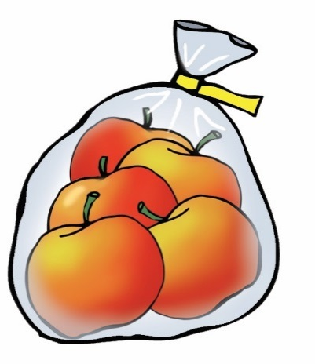
Multiple representations
Concrete
The DOING
Demonstrating depth
Pictorial
The SEEING
Abstract
The SYMBOLIC
5
/‘faɪv/
five
Notes:
Time: 4 minutes
Purpose: To understand the CPA approach
Facilitation: Explain that the concrete pictorial abstract approach is not a new concept that Mathematics Mastery has ‘discovered’. It is based on research by Jerome Bruner, a psychologist who has worked extensively in the field of educational research, in 1960s. He summarised the process of learning by saying that for the learning of anything abstract, it must be experienced first. By experienced, we mean the manipulation of real objects and seeing how they can then be represented pictorially before the symbols are introduced. Initially it is a linear process starting with the concrete. Run animation. Emphasise that the concrete apples can be represented by other abstract /objects that can be manipulated, e.g. counter/cube. Make these links explicit and likewise with the picture of the apples and the dots. The speech bubble is the phonetic spelling of five.
However, for pupils to develop understanding of a concept fully, reinforcement is achieved by going back and forth between these representations. What’s important when we have learnt the symbol is that we should not then lose sight of what the “five-ness of five” means; we need to work with the abstract alongside the pictorial and the concrete to maintain and deepen understanding. Repeat the language from the key principles triangle: Pupils make connections between different representations and consider what different representations stress and ignore.
Leads into next slide: Further explore multiple representations.

Slide 13


Talk Task
What does each representation of 36 reveal about the number?
1)
2)
Tens | Ones
3 | 6
3)
5)
4)
6)
Conceptual understanding
Pupils deepen their understanding by representing concepts using objects and pictures, making connections between different representations and thinking about what different representations stress and ignore.
Can you think of other representations?
Notes:
Time: 5 minutes
Purpose: Developing conceptual understanding through multiple representations
Facilitation: Get teachers to discuss the advantages and limitations of each representation:
Using Dienes reveals the place value aspect of the number and allows clear links between the magnitude of each place
Abstract symbols are the more efficient way to record numbers
One-to-one correspondence,
Tally - normally used in a data recording situation. This representation reveals that 36 = 6 x 5 + 1 showing that it is not divisible by five.
A 6 x 6 grid shows that 36 is a square number. Can you use this to see that 36 is 11 more that 5² or 20 more than 4² …
The bead string is arranged to show two groups of 18 – is this the best way? Does this support understanding of even numbers? How else could 36 be partitioned?
The focus here is for participants to identify the opportunities available through multiple representations to reveal underlying structures and make connections between aspects of mathematics. The concrete and/or pictorial representation of the number is more useful to develop a conceptual understanding that the place value abstract representation. However, the place-value representation has its place in developing a conceptual understanding as it is more efficient to record numbers in abstract form.
Leads into next slide: What manipulatives do we have?

Slide 14
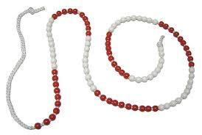
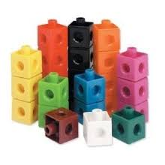
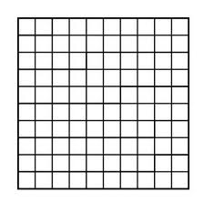
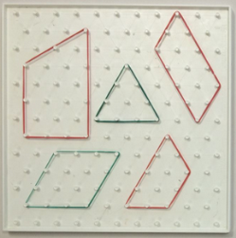
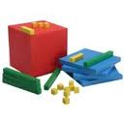
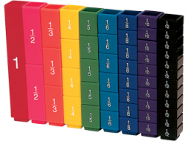
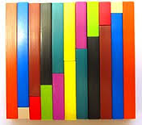
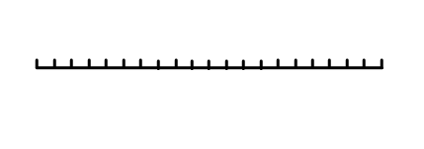
Tools for representations
Bead strings
Multilink cubes
100 grids
Geoboards
Dienes blocks
Fraction blocks
Cuisenaire rods
Number lines
What have we got?
What do we/don’t we use?
What might the barriers be?
Notes:
Time: 3 minutes
Purpose: Review use of manipulatives in the school.
Facilitation: Use this slide as a prompt for discussion on how you already work with manipulatives in school and to ‘stock’ check what you have. Take brief feedback.
Leads into next slide: Moving onto next key principle, language and communication.

Slide 15
Key Principles
Language and communication
Pupils deepen their understanding by explaining, creating problems, justifying and proving using mathematical language. This acts as a scaffold for their thinking deepening their understanding further.
Conceptual understanding
Mathematical problem solving
Mathematical thinking
Language and communication
Notes:
Time: 1 minute
Purpose: Focus on the key principle of language and communication
Facilitation: We will now focus on language and communication. Read through the blue explanation box.
Leads into next slide: Thinking about the importance of language…

Slide 16
What comes next…?
Thousands
Hundreds
Tens
Ones!!
Notes:
Time: 1 minute
Purpose: Consider place value language
Facilitation: Animated slide – ask participants what comes next in the place value sequence. Reveal ‘ones’. Using ‘ones’ and not ‘units’ is important for understanding the ‘oneness of one’. A ‘unit’ could define a unit of measurement for example, which may have a value greater than one. In MM, it is important to expect correct mathematical language use from pupils and that adults model correct vocabulary at all times.
Leads into next slide: Why ones?

Slide 17



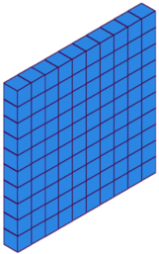
Why ‘ones’?
one ten = ten ones
ten ones = one ten
one hundred = ten tens
ten tens = one hundred
Notes:
Time: 2 minutes
Purpose: Reasons for using ‘ones’
Facilitation: Explain our number system is based on ten. Each place is ten times larger/smaller than those either side. The structure and pattern is revealed by using the word ‘one’ because one is ten times smaller than ten. Using the word ‘unit’ is a missed opportunity to stress this and in fact, the word ‘unit’ can describe ‘a one’, ‘a ten’ or ‘a hundred’ and the process of making a unit from smaller units is known as unitising. The inverse of this is known as exchanging. Mathematics Mastery chooses to use the word ‘re-grouping’ to describe both.
The word unit can also get confused with units of measures.
Leads into next slide: We’re now going to watch a short language powerpoint.

Slide 18
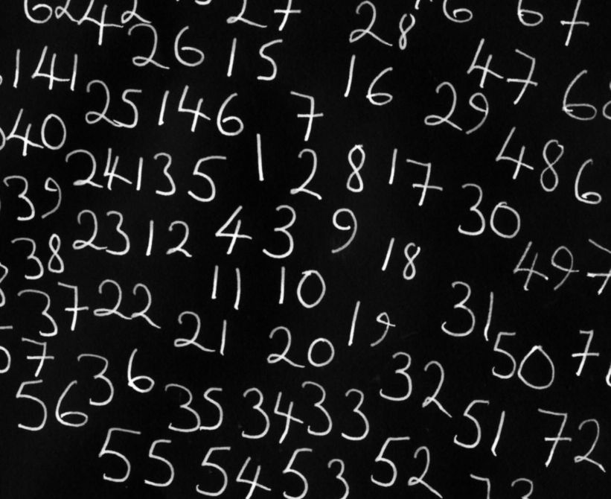
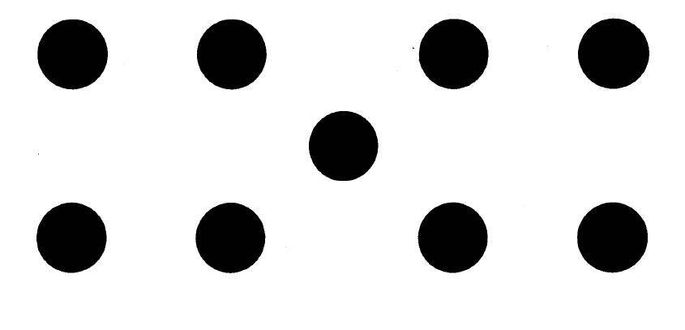
Count the Dots
Notes:
Time: 1 minute
Purpose: To describe in full sentences
Facilitation: This is the final slide in the language powerpoint – it is repeated here in case it needs more time. Use this slide to generate discussions and answers to the questions below:
Your task is to count the number of dots you see on this slide, and then describe how you did it – did you count one by one or did you see a pattern? Did you see it differently from anyone else in the room. Remember to answer in full sentences! This task reinforces importance of describing, reasoning, using mathematical vocabulary and expectations of TALK in mathematics to aid understanding.
Leads into next slide: We’re going to continue the theme of using mathematical language to aid understanding.

Slide 19
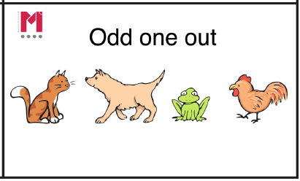
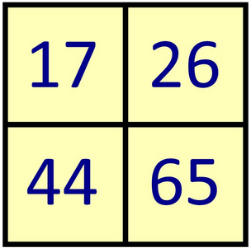
Which one doesn’t belong?
Find reasons why EACH one could be the odd one out!
Notes:
Time: 4 minutes
Purpose: Another mathematical task to reinforce importance of language to aid understanding.
Facilitation: Pose the question to participants and given them a chance to discuss in pairs/groups. Take feedback.
Some ideas:
65 – Only multiple of 5. Only one whose digit sum is not 8
44 – Only one with repeated digit. Only multiple of 4 (or 11). Only number that is not one more than a square number
17 – Only prime. Only one under 20.
26 – Only one with two different even digits. Only one that is an even multiple of 13.
Leads into next slide: So how do we facilitate mathematical talk?

Slide 20
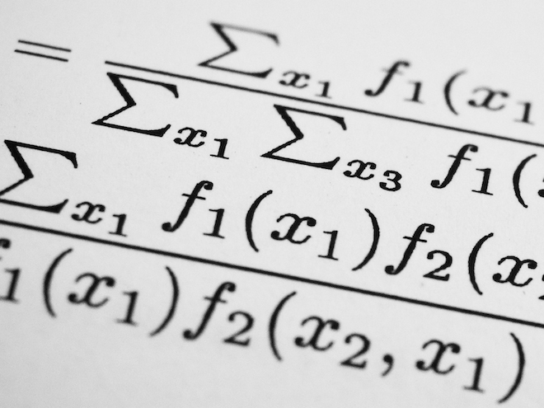
Number talk
Mentally evaluate 18 × 5
Explain your method
Did anybody do it in a different way?
Notes:
Time: 3 minutes
Purpose: How to facilitate talk
Facilitation: This slide gives further guidance on words to use when posing questions to develop language and, in turn, develop thinking (the next principle we will look at).
Identify with participants that mathematics is not always about calculating, but learning maths can also come from explanation of methods and identifying there is often more than one way to do something (another misconception that answers in maths is either right or wrong).
Ask participants what is being developed by posing these questions. Take feedback, encouraging participants to represent their method using concrete, pictorial and abstract representations.
Leads into next slide: some possible answers are given on the next slide.

Slide 21


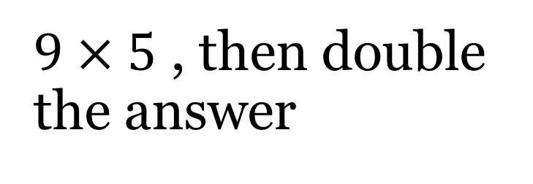



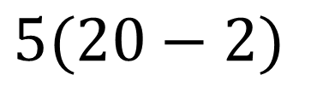




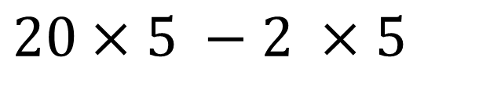


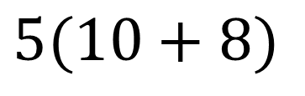
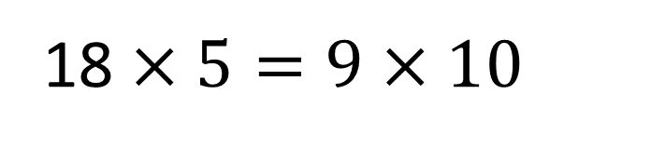
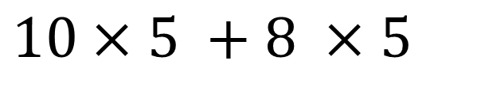


$18×5$ – some possibilities
$$10$$
$$8$$
$$10×5 +8 ×5$$
This can also be written as:
$$5$$
$$50$$
$$40$$
$$5(10+8)$$
$$20$$
$$2$$
$$20×5 −2 ×5$$
$$5$$
$$90$$
$$100$$
$$10$$
This can also be written as:
$$5(20−2)$$
9
$9×5$ , then double the answer
5
45
45
$$\text{10}$$
18 $×5=9 \text{×}\text{ 10}$
Notes:
Time: 5 minutes
Purpose: Feedback on number talk activity.
Facilitation: Talk through the methods used compared to some of those suggested and illustrated on the slide. Consider the area model representations and how they connect with the abstract notation.
“Number talks” like this are very useful for comparing and learning new strategies.
Leads into next slide: We’re now going to consider the final key principle, mathematical thinking.

Slide 22
Key Principles
Mathematical thinking
Pupils deepen their understanding by giving an examples, by sorting or comparing, or by looking for patterns and rules in the representations they are exploring problems with.
Conceptual understanding
Mathematical problem solving
Mathematical thinking
Language and communication
Notes:
Time: 2 minutes
Purpose: Focus on the key principle of mathematical thinking
Facilitation: The final key principle to look at is Mathematical thinking. Read through the green box.
Explain that Mathematical thinking happens at the same time as talking about maths and through conceptually representing mathematical ideas. It is therefore not always discrete (nor is conceptual understanding discrete from language and communication). However, there are some obvious techniques to develop mathematical thinking more openly.
Leads into next slide: Prompts and questions for promoting mathematical thinking.

Slide 23

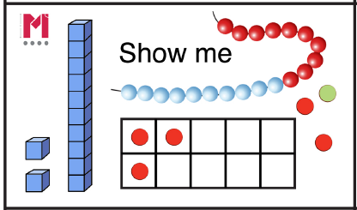
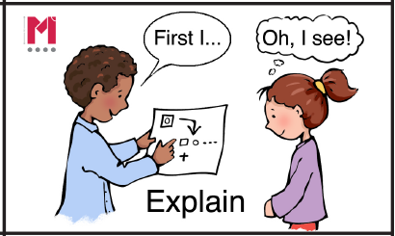
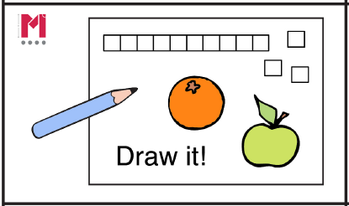
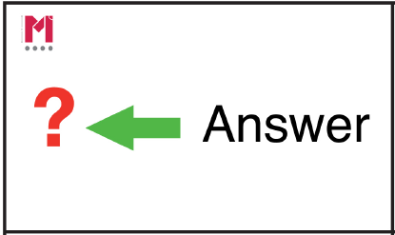
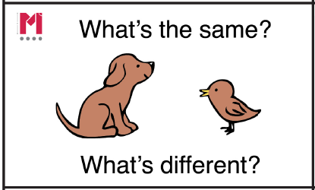
Promoting mathematical thinking
If we know this, what else do we know?
Why is that a good mistake?
Give me . . .tell me . . .show me . . .
Why is this the odd one out?
The answer is . . .what is the question?
Give me a silly answer for . . .?
What’s the same? What’s different?
Is it always, sometimes or never true?
Notes:
Time: 4 minutes
Purpose: Develop questioning to provide opportunities for mathematical thinking
Facilitation: Asking the right questions or giving thoughtful prompts can support the development of mathematical thinking. Here are some good examples that should be planned for, although some teachers may automatically include them in their teaching. The Next Steps for Depth prompts have been included and there is further information about these available on the Toolkit. Ask participants to discuss which questions they think are most likely to develop their pupils, and reflect on the questioning they currently do throughout a lesson.
Leads into next slide: Reflecting on today’s learning

Slide 24
Reflection
What can I apply from this session to improve my delivery of the Mastery approach?
Which activities from today could I incorporate into my mathematics teaching?
Notes:
Time: 2 minutes
Purpose: Reflection
Facilitation: Every SKEW session should end with a reflection and next steps. Discuss responses, or ask participants to jot down in their own notes.

Slide 25

Multiple meanings
Foot
Odd
Cancel
Translate
Prime
Mean
Power
Share
Root
Roughly
Take Away
Product
Volume
Notes:
Firstly, we need to be aware of the sheer quantity of mathematical vocabulary that there is. This list is just a small sample of the words that have a different meaning in mathematics than they do in other contexts – the volume of a shape, for example, is very different to the volume on a television set. All these words need carful introduction and explanation, often, as in these cases, to be distinguished from other meanings.

Slide 26
What number is half of 6?
6 is half of what number?
Notes:
Let’s think now about what happens when you put words together to form sentences, or questions. To us as teachers, this question seems simple and the answer is of course three. If, however, I rearrange the words…then the answer is now twelve. The questions look very similar indeed but have different answers, so it’s important to consider the structure of the sentences as well as the words within them. A classic literacy strategy to help with problems like this is to highlight the key words…

Slide 27
What number is half of 6?
6 is half of what number?
Notes:
….but as you can see, in this case that’s not particularly helpful; the words are the same and the key words are the same. To answer the question correctly, you really need to think about the structure.

Slide 28
Things NOT to say!
“Two minuses make a plus.”
…but – 3 – 4 = – 7!
Notes:
We also have to be careful with “short-cut” phrase that we may have been taught ourselves but aren’t actually correct (or at least aren’t always correct) and so can be very misleading. This is a common phrase pupils often say…but it isn’t actually true. Looking at the calculation, you can see there are two minuses, negative three subtract four, but the answer isn’t positive seven.

Slide 29
Things NOT to say
“To multiply by 10, just add a zero.”
…but 3.4 × 10= 34 (not 3.40)!
Notes:
Here’s another one…but it only works for integers, not decimals, so again it is usually not true.

Slide 30
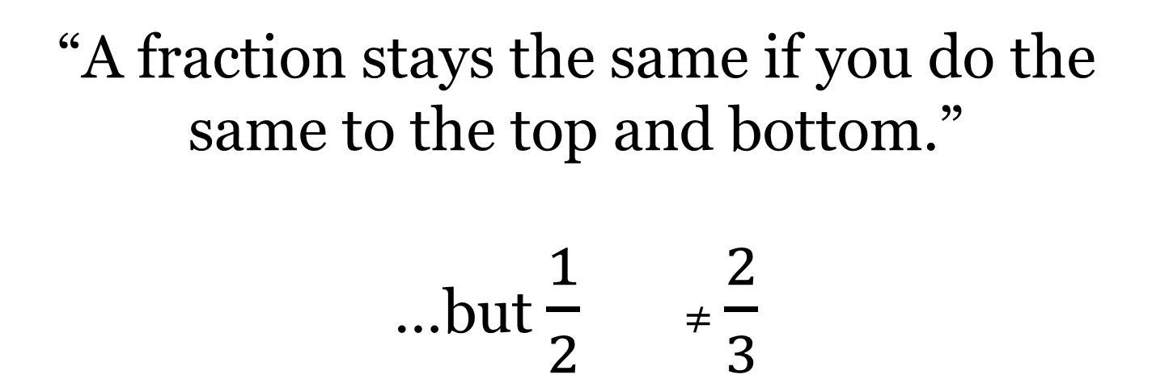
Things NOT to say
“A fraction stays the same if you do the same to the top and bottom.”
…but $\frac{1}{2}$ ≠ $\frac{2}{3}$
+ 1
+ 1
Notes:
Here’s another example of imprecise language. It’s true that the value of a fraction is unchanged if you multiply or divide the numerator and denominator by the same number, but not generally if you add or subtract. Also in this case, using terms like” top and bottom” aren’t helpful; if we expect pupils to remember and use key vocabulary then we should use it ourselves at all times.

Slide 31
Expectations
Model
Pupils use correct mathematical vocabulary at all times
Pupils speak in full sentences
Pupils engage in mathematical talk
Pupils look for patterns, make conjectures
Notes:
Which brings us neatly to the expectations we should have of ourselves and our pupils.
Firstly, modelling correct language, correct vocabulary and correct sentence structure at all times
Then, expecting the same of our pupil and encouraging them and supporting them to do so, both in terms if vocabulary
…and full sentences, the structure of which will help support their understanding and help to develop their reasoning skills
….To achieve this, we need to create as many opportunities as we can for pupils to practise their mathematical talk, in particular to
…help them move forward with their mathematical thinking by seeking out and describing patterns, coming up with and testing their own ideas and discoveries

Slide 32
Ways of developing talk
Talk partners
Think, pair, share
Clear rules and ‘Ready to share’ signal
Building on answers – “Why did. . .?” “How else. . ?” “What if you. . .?”
Make sure “talk tasks” are accessible
Notes:
Some pupils may initially need encouragement to join in mathematical talk. Remember we are trying to help them share ideas rather than just give an answer, which can sometimes be stressful.
It’s often easier to start talks in pairs and employ strategies like think, pair, share to give pupils the time and space to formulate their ideas, and (if necessary) repeat the process to enable them to correct their language or re-phrase as whole sentences.
We also need to be clear about expectations of who’s talking when and listening to each other
Equally important, the answer to teacher’s question is often only the beginning of a session of mathematical talk – your follow-up questions are then really powerful in helping the pupils to think deeper and further into the topic being discussed.
It’s also important to realise that questions don’t need to be hard! Choosing tasks that enable pupils to get into the mathematics is very important.
So, to finish off this presentation, here’s one for you:

Slide 33
Count the Dots
Notes:
Your task is to count the number of dots you see on this slide, and then describe how you did it – did you count one by one or did you see a pattern? Did you see it differently from anyone else in the room? Remember to answer in full sentences!

