Slide 1
Manual Handling

Slide 2
Definition of Manual Handling
The transporting or supporting of a load by hand or some other part of the body including the lifting, putting down, pushing, pulling, carrying, moving or intentionally dropping or throwing a load

Slide 3
Accident Statistics
Largest cause of accidents at work
37% Manual Handling
19% Slips, Trips and Falls
12% Other Causes
20% Struck by an Object
7% Falling from Height
5% Machinery

Slide 4
Mechanics
Balance point is through centre of body when standing
A load held in front disturbs the balance - tension is generated in the back muscles to compensate
Forms a lever effect
Average person holding a 10kg load at arms length generates a counterbalancing tension up to 10 times more – to avoid falling over
High or repetitive levels of tension in the back can cause damage – called muscle strain

Slide 5
Mechanics
Centre of Gravity
Centre of Gravity
Lever effect is reduced if load held closer to the body

Slide 6
Manual Handling Regulations 1992
Regulations provide a hierarchy of measures
Employers must:
  Avoid manual handling where possible
  Assess any hazardous activities where manual handling can’t be avoided
  If the assessment indicates a significant risk of injury a more specific assessment must be made
  Reduce the risk of injury as far as is reasonably practicable

Slide 7
Manual Handling Regulations 1992
Employees have duties:
  Follow the laid down systems of work
  Make proper use of equipment provided
  Co-operate in H&S matters
  Advise your manager if you are unwell
  Not putting other people at risk

Slide 8

Risk Assessment
T Task
I Individual’s capabilities
L Load
E Environment
    any other factors

Slide 9
The Task
Holding loads away from body
Twisting
Stooping
Reaching upwards
Large vertical movements
Long travel distances
Strenuous pushing and pulling
Unpredictable movement of load
Repetitive handling
Insufficient rest or recovery time
Work rate imposed by the process

Slide 10
Individual Capability
Physical condition
Illness
Pregnancy
Requires unusual capabilities
Call for special information or training

Slide 11
The Load
Heavy
Bulky or unwieldy
Difficult to grasp
Unstable/unpredictable
Harmful ie sharp/hot

Slide 12
The Working Environment
Constraints on posture eg lack of space
Poor flooring
Variations in levels
Hot/cold/rain/ice/humid conditions
Strong air movement
Poor lighting conditions

Slide 13
Other Factors
and people!!
High Stress
Poor Diet
Lack of exercise
Rushing – pressure of work
Short cuts
Is movement hindered by clothing or personal protective clothing

Slide 14
Risk Assessment Summary
Identify the elements of significant risk
Decide who might be harmed and how
Evaluate risks/Control measures
Record the findings of assessment
Review/revise assessment
T Task
I Individual’s capabilities
L Load
E Environment

Slide 15
Lifting Safely
Ultimate Objective:
To Relieve Fatigue & Strain
Use correct handling techniques
Ensure good vision
Change position regularly
Avoid over reaching or stretching
Adjust work surface heights
Relax where possible
Use mechanical aids

Slide 16
Kinetic Lifting
Summarised by:
Plan the Route
Assess the load
Correct position of feet
Straight back
Correct grip
Lift smoothly

Slide 17
Kinetic Lifting
Plan the Route
Where is the load going
Are there obstructions in the way
Is there somewhere to set it down

Slide 18
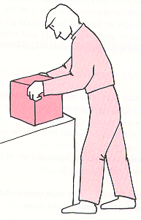
Kinetic Lifting
One Person Lift
Determine the weight
Look for sharp edges
See if weight is evenly distributed
Keep heaviest side to body
Decide how to hold the load
If it is too heavy use a trolley or get assistance

Slide 19
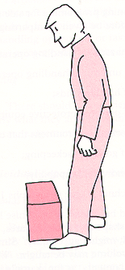
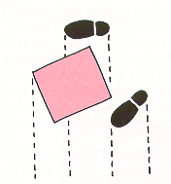
Kinetic Lifting
Correct Positioning of Feet
Comfortably apart
One foot positioned in direction of movement
Other foot where it can give maximum thrust to the body
To maintain good balance feet should never be too close together on the ground

Slide 20
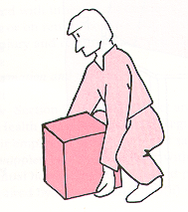
Kinetic Lifting
Straight Back
Lower the body by relaxing the knees
Keep your back straight (but not vertical)
Keep load close to body
Keep chin in and head back

Slide 21
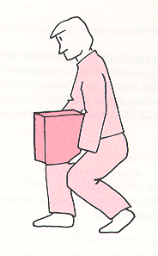
Kinetic Lifting
Lifting
If lifting from ground make maximum use of legs
Keep back straight but inclined forward
As lift proceeds and the legs are straightened the back returns to vertical position
Positioning of feet and bending of knees are the key factors in maintaining a straight back

Slide 22
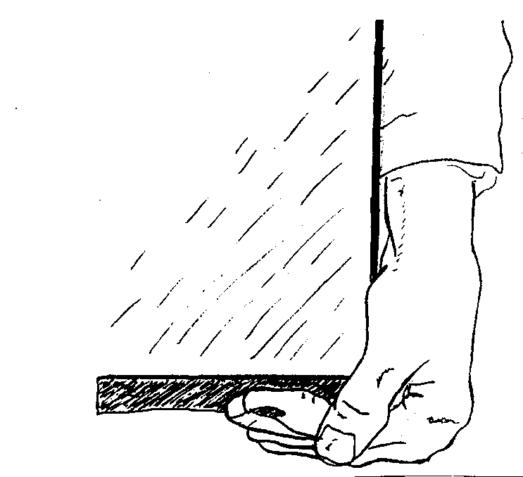
Kinetic Lifting
Correct Grip
Take a firm grip by using the palms of the hands and roots of fingers
Taking weight on finger tips will create pressure at the end of fingers and could strain muscles and tendons in the arms
A full palm grip will reduce muscle stress to the arms and decrease the possibility of the load slipping

Slide 23
Kinetic Lifting
Lifting Smoothly
Thrust from back foot and straightening of knees will move body forwards and upwards – briefly off balance
Immediately countered by bringing the back foot forward as if walking
Lift now completed - forward movement results in smooth transition from lifting to carrying

Slide 24
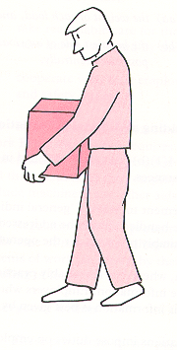
Kinetic Lifting
Carrying the Load
Make sure you can see where you are going
Avoid twisting the body – move your feet instead
If you need to change your grip – set the load down – not whilst walking
Setting the Load Down
Use the correct stance for lifting and set the load down gently

Slide 25
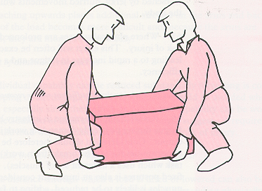
Kinetic Lifting
Two Person Lift
Decide who will be caller
Assess the weight
Correct positioning of feet
Straight back
Correct grip
Lift together
The caller co-ordinates the lift and ensures each lifter knows what to do and when

Slide 26
Kinetic Lifting
Summary
Plan the route, the lift and the set down point
Position your feet - bent knees, straight back
Firm grip, lift smoothly,
Move the feet – do not twist body
Keep the load close to the body
Put down smoothly – then adjust for final position

