Slide 1
Fire Safety
September 2023

Slide 2
Elements of fire
sources of ignition
  include heaters, lighting, naked flames, electrical equipment, smokers’ materials (cigarettes, matches etc), and anything else that can get very hot or cause sparks
sources of fuel
  include wood, paper, plastic, rubber or foam, loose packaging materials, waste rubbish and furniture
sources of oxygen
  include the air around us

Slide 3
The action employees should take if they discover a fire?
Immediately operate the nearest alarm call-point
If the fire is small and you are trained to use fire extinguishers, you may attempt to tackle the fire without taking any personal risks

Slide 4
How will people be warned there is a fire?
The electrical fire alarm system will sound on operation of the manually operated alarm call-point

Slide 5
How will the evacuation of the building be carried out?
On hearing the alarm;
  Everyone in the building should leave the building by the nearest exit and report to the assembly point
  Visitors should be escorted from the building and accounted for at the assembly point

Slide 6
Identification of escape routes
All exit doors can be used as escape routes

Slide 7
Fire fighting equipment provided
Fire extinguishers are located in circulation areas and near fire exit doors
Only trained employees should attempt to fight a fire and only if it is safe to do so without taking personal risks

Slide 8
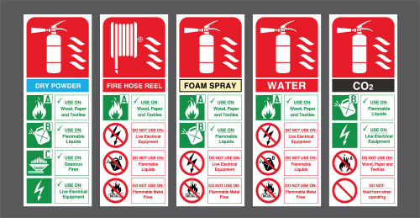
Fire extinguishers explained

Slide 9
Duties of employees in the event of a fire
On hearing the alarm;
  All staff should ensure that everyone leaves the building in a safe and efficient manner assembling at the muster point
  Staff with baton responsibility should sweep their areas quickly, shutting doors and window if safe to do so and assemble at the muster point
  Admin Office staff to collect medication, whole school registers and visitor sign in and assemble at the muster point
  Registers taken and any missing pupils, staff, visitors or contractors identified

Slide 10
Arrangements for safe evacuation of people identified as being especially at risk, such as contractors, those with disabilities, members of public and visitors
Consider;
  Visitors
  Contractors
  People with Disabilities

Slide 11
How will the fire service and any necessary emergency services be called and who will be responsible for doing this
On confirmation of fire the Executive Head or Head of School will Dial 999 and ask for the Fire Service or other emergency service as appropriate

Slide 12
Procedures for liaising with the fire service on arrival and notifying them of any specific risks, e.g. the location of highly flammable materials
The Estate Manager or Deputy will liaise with the Fire Brigade on their arrival

Slide 13
The following arrangements and training is given to staff at the centre:
All staff – fire drills three times a year
All staff – fire briefing once a year
Record of training to kept within fire manual
Training to reviewed on a yearly basis

Slide 14
Fire safety plans
a clear passageway to all escape routes
clearly marked escape routes that are as short and direct as possible
enough exits and routes for all people to escape
emergency doors that open easily
emergency lighting where needed
training for all employees to know and use the escape routes
a safe meeting point for staff and children

Slide 15
Summary - Know you fire plan
What should you do first if you discover a fire?
What shouldn’t you do?
What should you do if you hear the fire alarm?
Who needs further consideration?

