Slide 1
Inclusion at Repton Manor Primary School

Slide 2
Aims of the session …
To have a greater understanding of the SEND Profile for the school.
To have an understanding of the Mainstream Core Standards and how they can inform/ develop our daily practice.

Slide 3
Activity 1
You need to be in a group of 5.
Person 1 will be the student. Your job is to listen to Person 5 who will be reading an article that you will have to answer questions on.
Person 2 – stand behind person 1. You need to rub the back of their neck with the piece of card. Do not do this too hard but repeat this action.
Person 3 – you are to chant the alphabet or the timetables in to Person 1’s ear. You need to do this in a loud voice for the duration.
Person 4 – pat Person 1 on the head and shoulder repeatedly. Again not too hard!
Person 5 - using a normal voice, read a paragraph to Person 1 then ask them questions about what you are reading. DO NOT drown them out the other noises.

Slide 4
SEND Profile at Repton Manor
Number of Children identified as SEND (not including Yr R) – 65 (13.7%) Term 6 (20-21) 76 chn (15.8%)
Number of Children identified as SEN Support – 55 (11.6%)
Comparison to Kent - 10.5%
Comparison to National – 12.6%
Number of Children with an EHCP – 10 children (2.1%) 2 definite applications with a further potential of 2 more.
Comparison to Kent - 3.8%
Comparison to National – 3.3%
Number of Children in receipt of HNF – 12 children (2.5% of school/ 18.5% of SEND register) 2 definite applications with a further potential of 2 more.
Number of Children with Personalised Plans– 38 children (8% of school/ 58.5% of SEND register) 1 more set of plans to be written – not including Reception.

Slide 5
SEND Profile at Repton Manor
% of children identified as Social, Emotional & Mental Health (SEMH) – 9 (13.8% of SEND Register – 1.9% of School)
% of children identified as Communication and Interaction
(C& I) – 38 children (58.5% of SEND Register – 8% of School)
% of children identified as Cognition and Learning (C&L) – 15 (23% of SEND Register – 3% of School)
% of children identified as Sensory and/ or Physical (S&P) – 3 (4.6% of SEND Register – 0.6% of School)

Slide 6
SEND Profile at Repton Manor
Communication and Interaction:
Speech & Language Therapy – 4.8% NHS SALT/ 0.4% Sch SALT Int. NB: Not including the reception children.
ASD – 3.4% with Diagnosis/ 2.5% awaiting assessment
Sensory and/ or Physical:
Physical – 1.7%
Vision – 0.2%
Medical - 1%

Slide 7
SEND Profile at Repton Manor
Social, Emotional and Mental Health:
ADHD/ ADD– 0% with Diagnosis/ 1.5% awaiting Diagnosis
Attachment/ Trauma – 0.2%
Cognition and Learning:
Global Developmental Delay – 0.2%
Dyslexia – 2.1% of chn with diagnosis/ tendencies

Slide 8
Definition of Special Educational Needs and Disability (SEND)
Special Educational Needs:
A child or young person has SEN if they have a learning difficulty or disability which calls for special educational provision to be made for him or her.
A child of compulsory school age or a young person has a learning difficulty or disability if he or she:
has a significantly greater difficulty in learning than the majority of others of the same age, or
has a disability which prevents or hinders him or her from making use of facilities of a kind generally provided for others of the same age in mainstreams schools.
(Special educational needs and disability code of practice: 0-25 years, January 2015, p. 15-16)

Slide 9
Definition of SEN Support
The definition of what constitutes SEN Support is less clear. In order to help schools, colleges and Early Years settings accurately identify their SEN Support cohort, KCC provides the following clarification of what constitutes SEN Support:
"SEN support is intensive and personalised intervention which is required to enable the child/young person (CYP) to be engaged in learning. It will usually involve significant amounts of resource from the educational setting (approaching, or in a minority of cases exceeding, the nationally prescribed threshold for schools and colleges). Each CYP identified as SEN Support will have Outcomes which have been agreed through a process of collaboration and discussion. A personalised programme of support will be devised and be reviewed and adjusted frequently (at least three times per year) with close CYP and/or parental involvement."

Slide 10
Tiered Approach to SEND Provision
Quality First Teaching – differentiation based on abilities and starting points, including a range of learning styles.
Provision Maps – interventions identified and targeted at key areas. Interventions should be tracked and monitored via provision. All intervention should follow the graduated approach.
Pupils Raised to Phase Leaders, PINC team or via Class Tutorials. Consider next steps and discussing if child needs to be identified as having Special Educational Needs and/ or disability.
Personalised Plans with identified long term outcomes agreed with parents – reviewed a minimum of 3 times a year. Ensuring ‘best endeavours’ and the graduated approach is being implemented.

Slide 11
Tiered Approach to SEND Provision (cont)
Access to outside agencies if appropriate – LIFT, Educational/ Clinical Psychology, OT, SALT etc.
If the provision identified for a child as part of their personalised plan exceeds £6000, we would consider an application for High Needs Funding (HNF).
Application for Statutory Assessment (EHCP) - If still requiring high levels of support with provision plans and HNF in place and making limited to no progress.

Slide 12
ACTIVITY 2 – No Words
In groups of 5.
Using a slip of paper write a simple message on the paper.
Swap your message with another member of your group.
Take it in turns to communicate the message to the rest of the group without writing, speaking or using any letters of the alphabet.

Slide 13
Introducing the New Mainstream Core Standards (MSC)
The Mainstream Core Standards Guide for schools and parents can be found on our school website or by following the link below.
https://www.kelsi.org.uk/special-education-needs/special-educational-needs/the-mainstream-core-standards

Slide 14
Mainstream Core Standards
The Mainstream Core Standards is divided in two sections:
Section 1 – Expectations of all schools. This section outlines the expectations on all schools, according to the needs of the child/ young person.
Section 2 – Additional Support. Some learners with SEND will require more support than most peers. This support will be provided in addition to the support in section 1.

Slide 15
The purpose of the MSC.
• Outlines the provision that the local area expects to be made available for children and young people with SEND attending mainstream schools.
• It is a universal document, to support mainstream practitioners, aid local conversations and promote a consistent high-quality approach to SEND inclusion.
• Details a range of exemplar strategies and interventions that schools may adopt for each need type.

Slide 16
Section 1 – Expectations of the School
This section outlines the expectations on all schools, according to the needs of the child/young person. Broadly speaking much of this section will be an integral part of the school’s provision for all children.
It outlines some of the practices and adaptations that are part and parcel of Quality First Teaching (QFT): the inclusion of all pupils in high-quality everyday personalised teaching.
The provision and strategies outlined in this section may be required for children and young people with SEN and/or disabilities but will undoubtedly be of benefit to many of the learners in the school.

Slide 17
Legal Duties of Schools in regards to SEND
The law is underpinned by the principle that where a parent of a child with SEN, or a young person with SEN, wants a place in a mainstream setting, they must not be denied it on the basis that mainstream education is unsuitable, or that their needs or disabilities are too great or complex.

Slide 18
Legal Duties of Schools in regards to SEND
Schools have clear duties in regard to the support of children and young people with special educational needs (“SEN”) and/or disabilities under the Children and Families Act 2014 and SEN and Disability Code of Practice 2015 (the “Code”).
Schools must “have regard” to the Code. This means that they should do what it says or be able to explain why they have not done so, and what alternative action has been taken.
Mainstream schools must ensure that children or young people with SEN engage in the activities of the school together with children or young people who do not have special educational needs (section 35 of the Children and Families Act 2014).

Slide 19
The ‘Best Endeavours’ Duty
The ‘Best Endeavours’ Duty: One of the key duties is for the school to use their ‘best endeavours’ to support children and young people with SEN. (This applies to mainstream and alternative provision settings.) This means doing everything that could reasonably be expected of them.
The law says: “If a registered pupil or a student at a school or other institution has special educational needs, the appropriate authority must, in exercising its functions in relation to the school or other institution, use its best endeavours to secure that the special educational provision called for by the pupil’s or student’s special educational needs is made.” (Section 66 of the Children and Families Act 2014)

Slide 20
The ‘Best Endeavours’ Duty
These duties apply to all children and young people with SEN whether they have an EHC plan or not.
Using best endeavours means doing everything they can to meet the child or young person’s SEN. It is a duty that requires the appropriate authority to enquire and ensure that the school is actually making the special educational provision that children and young people require.
The best endeavours duty requires schools to consider obtaining specialist help, such as a speech and language therapist or educational psychologist: “where a pupil continues to make less than expected progress, despite evidence based support and interventions that are matched to the pupil’s area of need, the school should consider involving specialists, including those secured by the school itself or from outside agencies.” (SEND CoP paragraph 6.58 for schools)

Slide 21
Working with children and young people, their families and carers
Read pages 5-15 – RAG rating.
Green – we are doing this and we are good at it.
Amber – we are on our way to achieving this.
Red – we are not doing this.
NB: SEND Information report is the SEND Policy

Slide 22
Break

Slide 23
ACTIVITY 3 – Instructions
In groups of 5 – each person will need a piece of paper and a pen.
1 person to draw a picture on their sheet of paper (hidden from the rest of the group) whilst drawing the picture describe what you are drawing.
The rest of the group to draw the picture.
Compare pictures once the task is complete

Slide 24
Section 2 – Additional Support
Some learners with SEND will require more support than most of their peers. This support will be provided in addition to the support set out in Section One.
Usually, when a learner is receiving this additional support, they will have an identified special educational need or disability or be presenting with characteristics that fall under one of the four broad areas of need set out in SEND Code of Practice 2015.

Slide 25
Four Broad Areas of Need:
Communication and Interaction (C&I) - Speech, language and communication needs (SLCN) and Autism or characteristics of aspects of Autism Spectrum (ASD/ ASC).
Cognition and Learning (C&L) – specific learning difficulties (SpLD) such as Dylsexia, Dyscalculia and Dyspraxia, as well as moderate learning difficulties (MLD), severe learning difficulties (SLD) and profound and multiple learning difficulties (PMLD).

Slide 26
Four Broad Areas of Need (cont.)
Social, Emotional and Mental Health Difficulties (SEMH) – social and emotional difficulties which manifest in many ways. Some children may have disorders such as; attention deficit disorder (ADD), attention deficit hyperactivity disorder (ADHD), ODD, Anxiety, depression, OCD or attachment disorder etc.
Sensory and/ or Physical Needs (S&P) – a child may have a disability that may prevent or hinder them making use of the educational facilities generally provided. Some children may have a visual impairment (VI), a hearing impairment (HI) or a multi-sensory impairment (MSI). Some children may have a physical disability (PD).

Slide 27
The Assess, Plan, Do, Review Cycle (APDR) and the Graduated Approach
3 I’s:
Intent, Implement & Impact
APDR – strategies and interventions that are regularly monitored, reviewed and evaluated to inform next steps.
Graduated Approach – an understanding of what is needed and what works best for a child, which can result in more support being put in place to ensure they are included and are making progress across the curriculum.

Slide 28
The Assess, Plan, Do, Review Cycle (APDR) and the Graduated Approach cont…
Provision is put in place in response to current presenting, underlying or emerging need and is not dependent on a child or young person receiving a formal diagnosis of a specific condition or disability.
Children and young people with EHCPs will receive provision to meet their needs as described in Sections One and Two, alongside the additional provision set out in Section F of their plan. (Section F is a legal requirement)
‘Children, young people and their families are the experts on the impact of their condition or disability. They often already know what helps when they’re in school (and what doesn’t) and will be able to share with you what helps when at home or out and about. Collaborative working with children, young people and their families is the starting point when planning, implementing and reviewing SEND provision.’

Slide 29
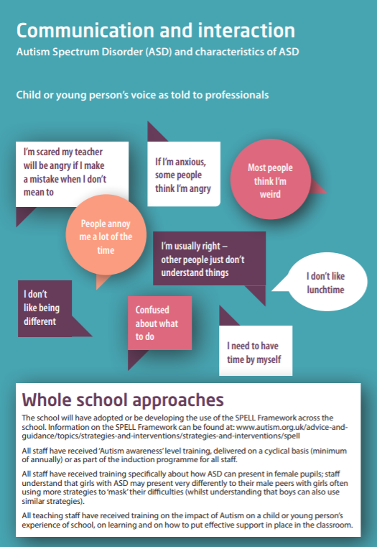
Each Section has a ‘What you will see’ and ‘What can Help’ section.

Slide 30
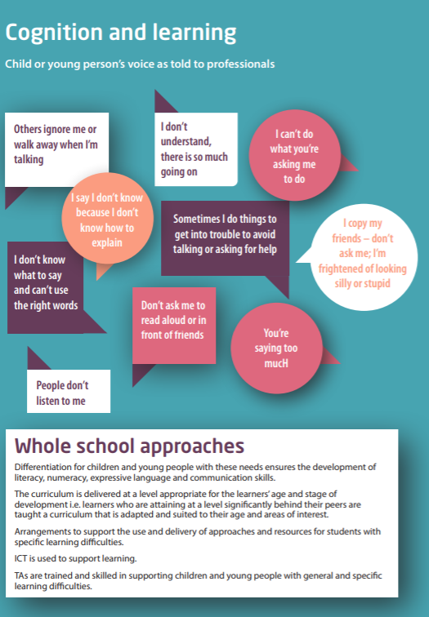
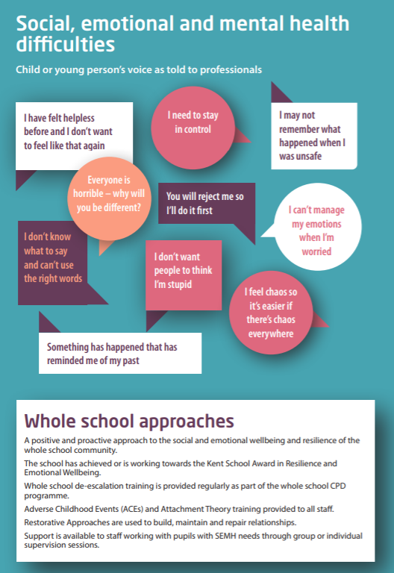

Slide 31
Case Studies Activities
Using section 2 of the Mainstream Core Standards – can you identify some strategies/ intervention to form a proposed provision action plan for a child.
NB: Remember the 3 I’s/ Plan, Do, Review and Assess process – sometimes less is more. How will you know which interventions are having impact?

Slide 32
Acronyms
SEND – Special Educational Needs and/ or Disability
EHCP – Educational Health Care Plan
HNF – High Needs Funding.
P/ Plans – Personalised Plans
SALT – Speech and Language Therapy
OT - Occupational Therapy
LIFT – Local Inclusion Forum Team
STLS – Specialist Teaching and Learning Service
EP – Educational Psychology
MSC – Mainstream Core Standards

Slide 33
Acronyms
CAMHS – Children and Adults Mental Health Services
ASD/ ASC – Autism Spectrum Disorder/ Condition
ADHD– Attention Deficit/ Hyperactivity Disorder
ADD – Attention Deficit Disorder
ODD – Oppositional Defiance Disorder
OCD – Obsessive-compulsive Disorder
MLD – Moderate Learning Difficulty
DCD – Developmental Co-ordination Disorder

