Slide 1
Shout outs / breakthroughs

Slide 2




Date:________________
LO: (LO statement directly from the framework)
We are learning to be… e.g. ‘Readers’
Prior Knowledge:
Objective from the framework.
(Share with the children what you learnt before and why/how that will help you today)
Steps to success:
(objectives from the framework or child speak)
Sticky Knowledge
(The knowledge everyone should be able to recall by the end of the lesson. It can be an objective from the framework or written in child speak)

Slide 3


Disciplinary Knowledge
How do we know about…
Example :
knowledge of how historians investigate the past, and how they construct historical claims, arguments and accounts.

Slide 4
Key vocabulary (with widgets and/or pictures)
Key Questions:
Adult support:

Slide 5
Input
Key Questions:
Include key questions
Include potential misconceptions
Visual, Auditory or Kinaesthetic leaders

Slide 6
Explanation of task (with differentiation, manipulatives/resources & adult support)

Slide 7
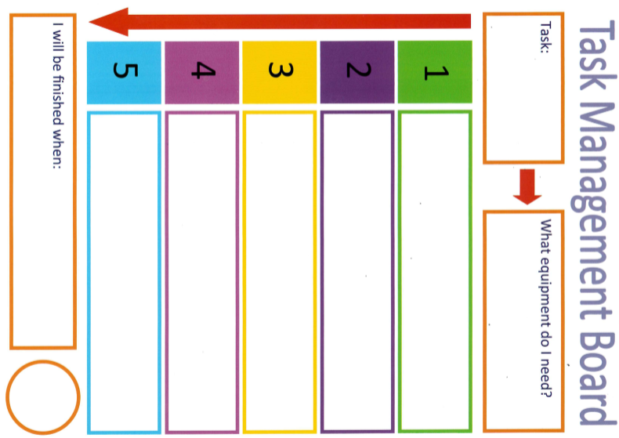
Extension activity

Slide 8
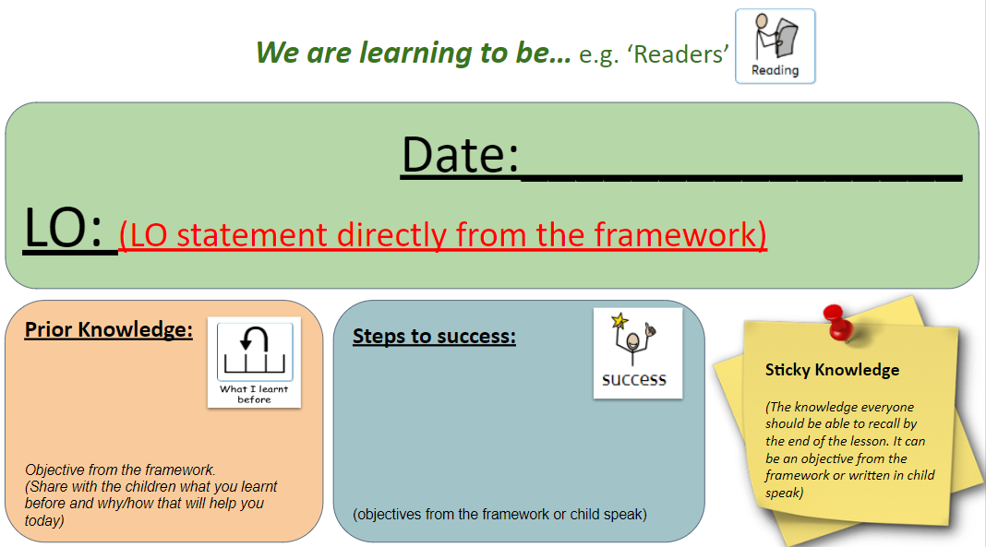
Plenary/mini plenaries (as appropriate)
Recap Slide 2.
What have we learnt today to help us to be better … (e.g. Readers)?

