Slide 1

LO: Develop questioning skills in order to improve children’s outcomes.

Slide 2

We all use questioning as part of everyday practice, but are we asking the right questions?
On a post it note, write down a question that you asked a child today.

Slide 3

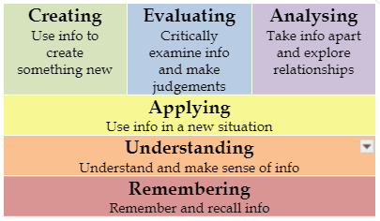
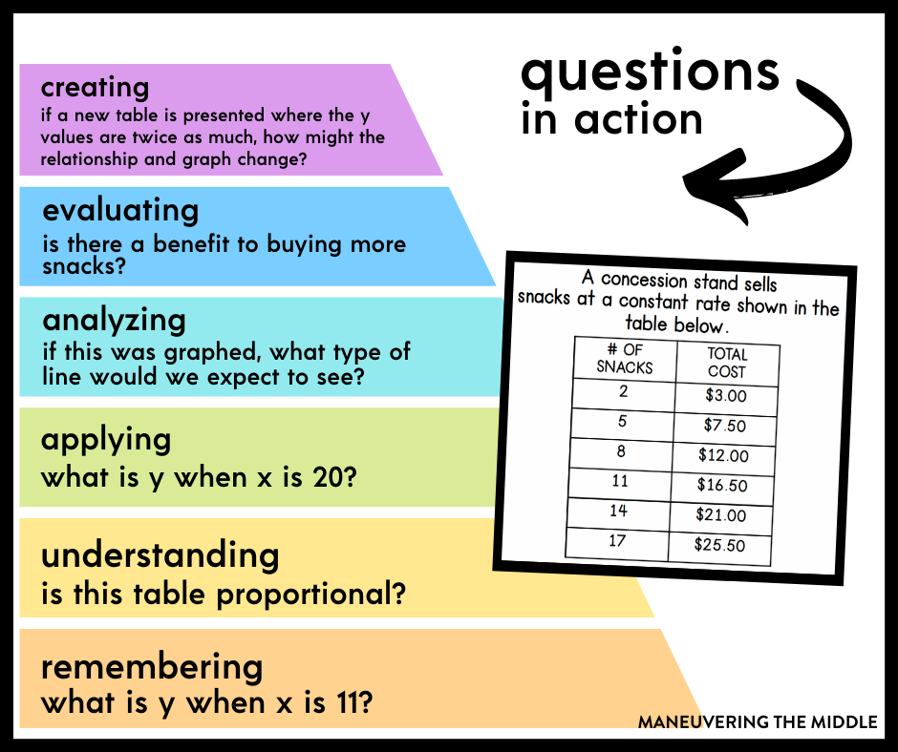
Higher level questioning
Questioning through our curriculum
(MTPs)

Slide 4
Higher level questioning
Apply
Solve problems by applying knowledge, facts, techniques and rules.
List of key words: Apply, Build, Choose, Construct, Demonstrate, Develop, Draw, Experiment with,
Illustrate, Interview, Make use of, Model, Organize, Plan, Select, Solve, Utilize
List of Question Starters:
Do you know of another instance where...?
Demonstrate how certain characters are similar or different?
Illustrate how the views and actions of the characters are shown.
What questions would you ask ...?
Can you illustrate...?
What choice does ... (character) have?

Slide 5
Higher level questioning
Analyse
Breaking information into parts to explore connections and relationships
List of key words: Analyze, Categorize, Classify, Compare, Contrast, Discover, Divide, Examine, Group, Inspect, Sequence, Simplify, Conclusions
List of Question Starters:
Which events could not have happened?
If ... happened, what might the ending have been?
How is... similar to...?
Can you distinguish between...?
What was the turning point?
What was the problem with...?
Why did... changes occur?

Slide 6
Higher level questioning
Evaluate
Justifying or defending a position or course of action
List of key words: Choose, Defend, Determine, Evaluate, Judge, Justify, Measure, Compare, Rate, Recommend, Select, Appraise, Prioritize, Support, Prove, Disprove. Assess,
List of Question Starters:
Can you defend the character’s actions/ views about...?
Do you think... is a good or bad thing?
Do you believe...?
What are the consequences...?
Why did the character choose...?
How can you determine the character’s/ persons motivation when...?

Slide 7
Higher level questioning
Creating
Generating new ideas, products or ways of viewing things.
• List of key words: Design, Construct, Produce, Invent, Combine, Compile, Develop, Formulate, Imagine,
Modify, Change, Improve, Elaborate, Plan, Propose, Solve
• List of Question Starters:
 What would happen if...?
 Can you see a possible solution to...?
 Do you agree with the actions?...with the outcomes?
 What is your opinion of...?
 What do you imagine would have been the outcome if... had made a different choice?
 Invent a new ending.
 What would you say to defend the actions of...?

Slide 8
Higher level questioning
To identify and compare the suitability of a variety of everyday materials, by identifying the uses of different materials.
Remember Understand Apply Analyse Evaluate Create
What is this material called?
Which material is waterproof?
If I wanted to build a house to survive rainstorm which materials would I use?
What would the problem be with using paper to build a house.
Can you explain why a builder would choose to build a house out of plastic and glass?
Can you think of a solution to help children keep their reading books dry in their bags.
Lower level
Higher level

Slide 9
Higher level questioning
LO: I can recount some interesting facts from a historical event.
The Great Fire of London.
Higher level
Remember Understand Apply Analyse Evaluate Create
Have a go at creating some higher order questions for this learning objective.

Slide 10
Higher level questioning
Year group objective/ piece of learning
Higher level
Remember Understand Apply Analyse Evaluate Create
Have a go at creating some higher order questions for a piece of learning from your medium term plan for this term.
The Great Fire of London, Dinosaurs, the Iron Age, Vikings, Anglo Saxons and Scots, WWI.

