Slide 1
Dyslexia Awareness Training
Writing Twilight - February 2024

Slide 2
Dyslexia - What does it mean for our dyslexic learners?
The Rose Report of 2009 went a long way to raise the profile of dyslexia, providing a clear definition:
‘Dyslexia is a learning difficulty that primarily affects the skills involved in accurate and fluent word reading and spelling.
Characteristic features of dyslexia are difficulties in phonological awareness, verbal memory and verbal processing speed.
Dyslexia occurs across the range of intellectual abilities.
It is thought best as a continuum, not a distinct category, and there are no clear cut-off points.
Co-occurring difficulties may be seen in aspects of language, motor coordination, mental calculation and personal organisation, but these are not, by themselves, markers of dyslexia.
A good indication of the severity and persistence of dyslexic difficulties can be gained by examining how the individual responds or has responded to well-founded intervention.’

Slide 3
Dyslexia - What does it mean for our dyslexic learners?
The British Dyslexia Association (BDA) supports the definition from the rose Report (2009) but also recognises that some dyslexic individuals encounter difficulties with visual processing. These include:
Visual stress - a perceptual processing condition causing print distortion and fatigue.
Visual tracking difficulties - the ability to focus on an object as it moves across the field of vision.
Binocular visual dysfunction - when the eyes do not function smoothly together.
Visual-motor perception - the ability to translate a visual image, or a visual plan into an accurate motor action i.e. coordination the eyes and hands to draw and write.
These difficulties can lead to dyslexic individuals having difficulties with the correct sequencing of letters for word formation, or to reverse letters and numbers. Some individuals may describe letters as ‘moving’ on the page, or they lose track of their reading as the move along the line of print. Additionally, some individuals may find it difficult and tiring to read black print when on a white background.

Slide 4
Phonological Abilities
In order to become a fluent reader children need to have secure abilities in:
Phonological Awareness - the ability to recognise the sounds in spoken words, to link letter shapes and sounds, sequence letter sounds to make words, or to divide words into smaller units of sound.
Phonological processing speed - the ability to process letters, words and sentences.
Verbal short-term memory - the ability to temporarily hold verbal information.
Verbal working memory - the ability to store and retrieve verbal information. E.g. recalling letters, numbers, a sentence etc.

Slide 5
The Dyslexia Friendly Classroom: High Quality Teaching and Differentiation
The ‘SEND Code of Practice, 2014’ states:
‘High quality teaching, differentiated for individual pupils, is the first step in responding to pupils who have or may have SEN. Additional intervention and support cannot compensate for a lack of good quality teaching.’
The key challenge for personalisation in the classroom is how to provide the support at the same time as meeting all the other different needs within the classroom.
The key is developing independent learners, who are supported in discovering how best to help themselves.

Slide 6
The Dyslexia Friendly Classroom: High Quality Teaching and Differentiation
Multisensory teaching and learning - ‘A multisensory teaching environment is one where there is active and interactive integration of visual, auditory, kinaesthetic and tactile elements’ (Rose 2009).
Most teaching techniques rely on either sight (visual) or hearing (auditory). Multisensory approaches enable learners to use their strengths to help them learn.
Incorporating a learners sense of touch (tactile) and movement (kinetic) - enables the learners brain to develop tactile and kinetic memories, as well as the auditory and visual ones. Therefore, strengthening the retention of learning and supports the weakness of traditional learning methods.

Slide 7
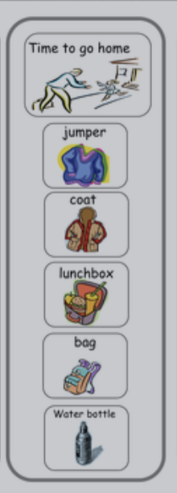
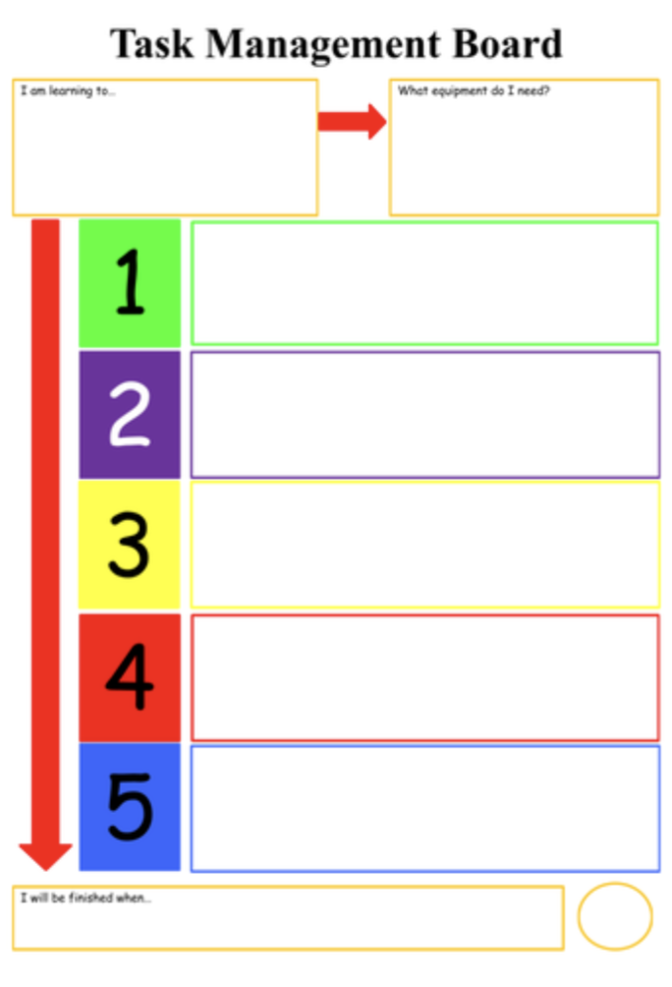
The Dyslexia Friendly Classroom: Useful Strategies to support learners
Leaving margins and writing on every other line - this will support eye tracking and editing.
Avoid white backgrounds - use buff, pale yellow or blue.
Use black or dark markers - avoid red or green as these can be difficult to read.
Use visual cues and prompts for regular forgotten facts e.g. items to take home, bring to school.
Use of visual timetables with colour coding (for older children).

Slide 8
The Dyslexia Friendly Classroom: Useful Strategies to support learners
Consider the font type and size - use at least 14pt font Arial, Comic Sans, Dyslexia with 1.5 line spacing for worksheets.
Recall of Instructions - break instructions in to small logical chunks and saying things in the correct order.
Slow down when speaking and reduce the amount of spoken language being used. Classroom studies show that some teachers talk 90% of the time!

Slide 9
The Dyslexia Friendly Classroom: Useful Strategies to support learners with Writing
Support spatial organisation issues by dividing the page into sections, e.g. for date / title / introduction / middle / end. This can be particularly helpful for maths activities and the laying out of equations.
Use paper with darker lines and wider spaces for those with visual discrimination difficulties.
For writing that slopes away from the margin use a green dot to signal where to start and a red dot where to finish.
Teach children how to make notes: Thought-showers, use of post-it notes to express each idea, lists, use of heading, flow charts, timelines, mind-mapping, story boards etc.
Use of writing frames and formats - 3 simple boxes to write notes for the beginning,middle and end of a story, extended boxes for extended stories, side boxes with notes for extra vocabulary and character development.

Slide 10
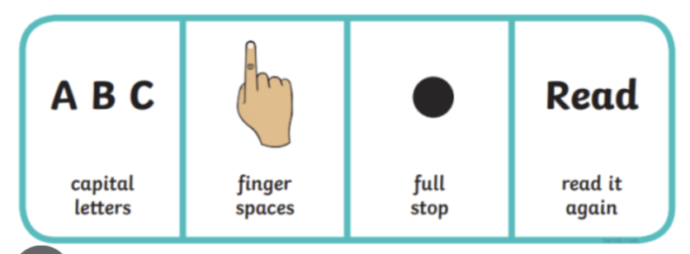
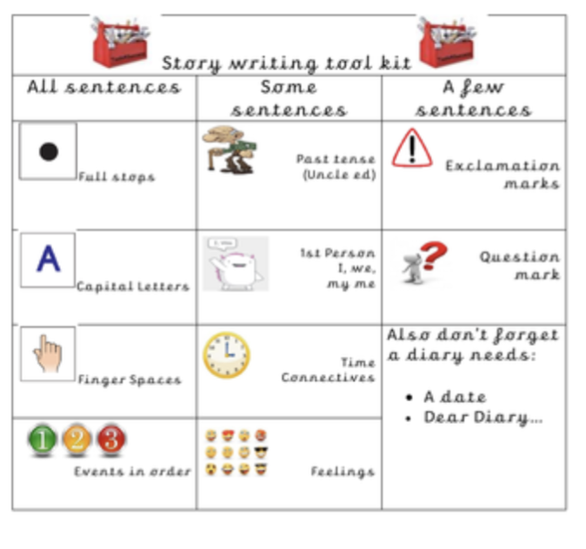
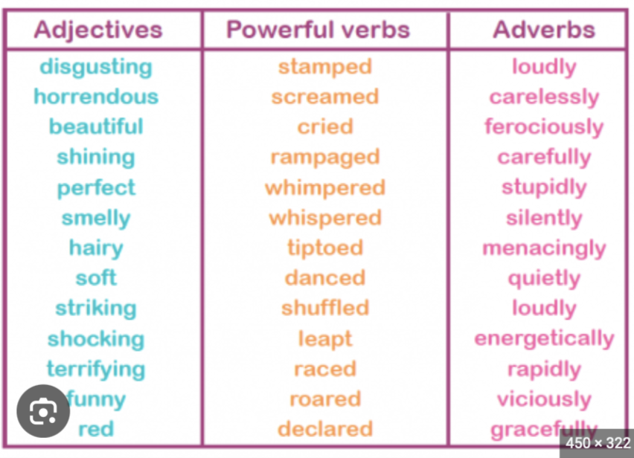
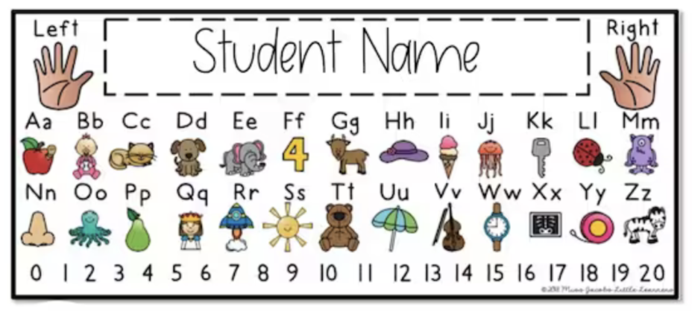
The Dyslexia Friendly Classroom: Useful Strategies to support learners with Writing
ICT support e.g. word processors, voice recorders etc.
Use of word banks for key vocabulary/ phrases/ sentences (ideally generated with the children) that could be used in their writing.
Alphabet strips - to support children identifying the correct upper/ lower case letter to use.
Extra time to complete learning tasks, with regular breaks and check ins.
Provide pictures, words, phrases or sentences to sequence for the pupils to add to.
Writing tool kits that are visually supported.

Slide 11
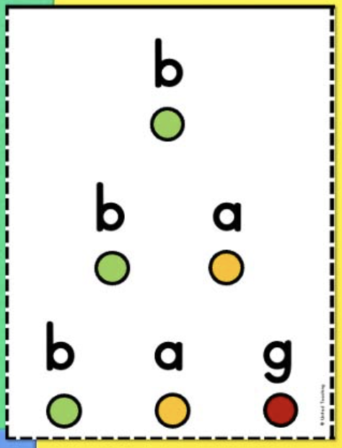
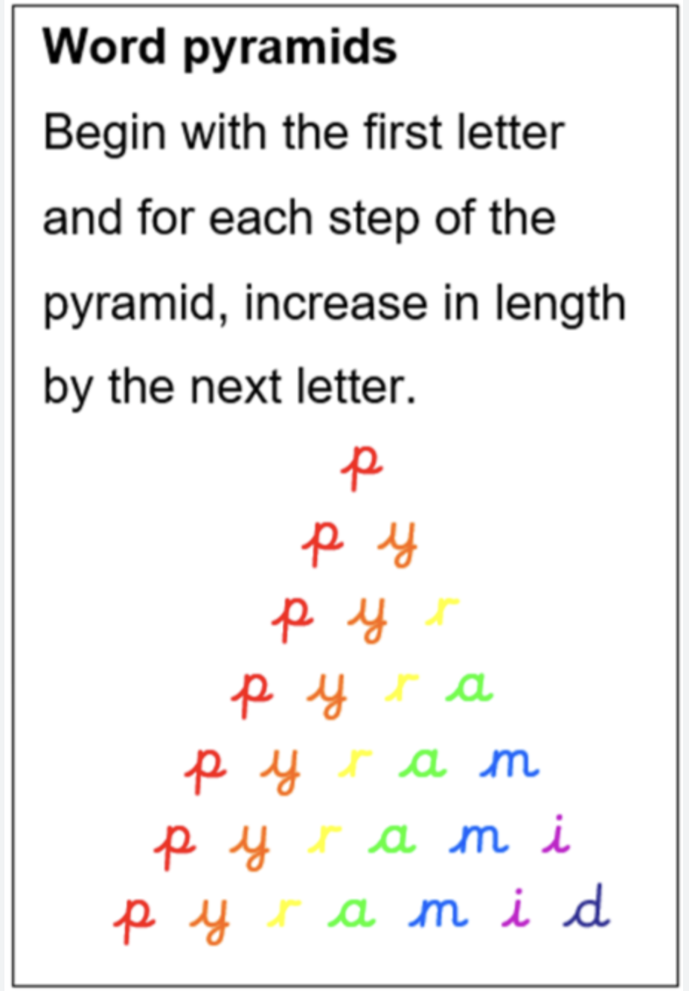
The Dyslexia Friendly Classroom: Useful Strategies to support learners with Spelling
Teach children to look for patterns/ letter sequences. Group words that contain common patterns; e.g. other, brother, mother, bother.
Picture books/ Vocabulary books - use pictures to learn key words
Tactile spelling - select so many solid letters, follow the shape of the letters, draw 1 of the letters on the child’s hand/ back. Can the child guess which letter it is? Develop the to words VC/CV, CVC/ VCC etc.
Pyramid Words/ Missing Letters -
This can be written, use a multisensory approach or using solid letters

Slide 12
The Dyslexia Friendly Classroom: Useful Strategies to support learners with Spelling
The Frenauld Tracing Technique
This technique is use for irregular words that need to be learnt quick or are tricky to spell.
Write the word in very large letters on a strip of paper (joined up writing)
Trace over the word with your fingers (or pencil/ pen/ crayon), saying each part of the word (letter names) aloud at the same time. Repeat several times.
Without looking at the original, write the word on a new piece if paper.
Repeat
Say it in funny way -
Make up your own rhyme/ silly phrase/ rhyme
w/ as = was choc/ o / late = chocolate Wed/ nes/ day = Wednesday

Slide 13
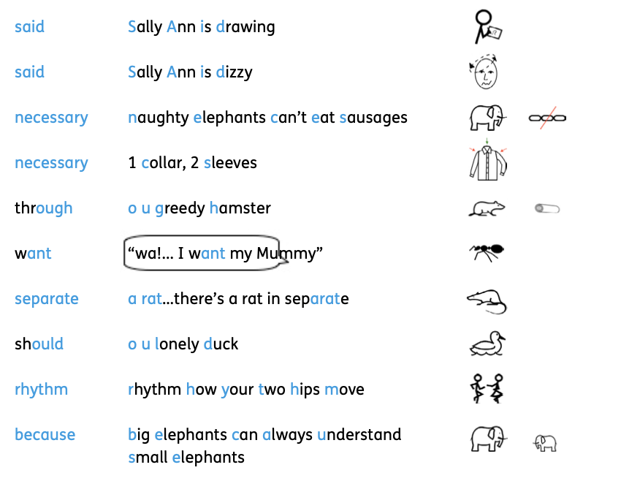
The Dyslexia Friendly Classroom: Useful Strategies to support learners with Spelling
Mnemonics

Slide 14
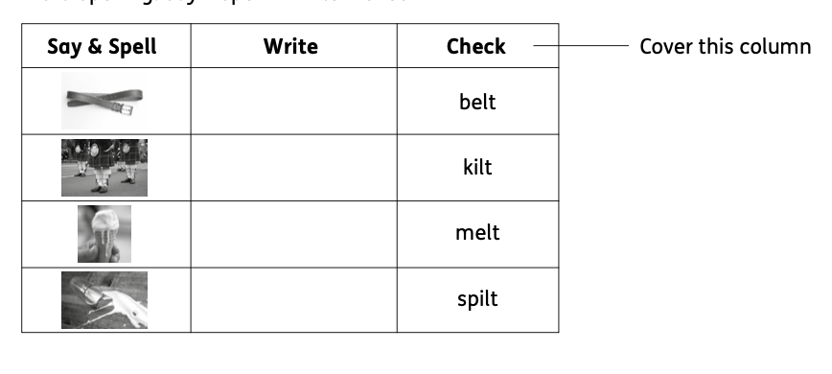
The Dyslexia Friendly Classroom: Useful Strategies to support learners with Spelling
Word skeleton boxes - looking at the shape of the letters and match the word to the skeleton box. Cover the word up and write the word in the skeleton box, say the letter names as you write the letters. Now write the word without looking at the word or the skeleton box.
Word Spelling: Say - Spell - Write - Check

Slide 15
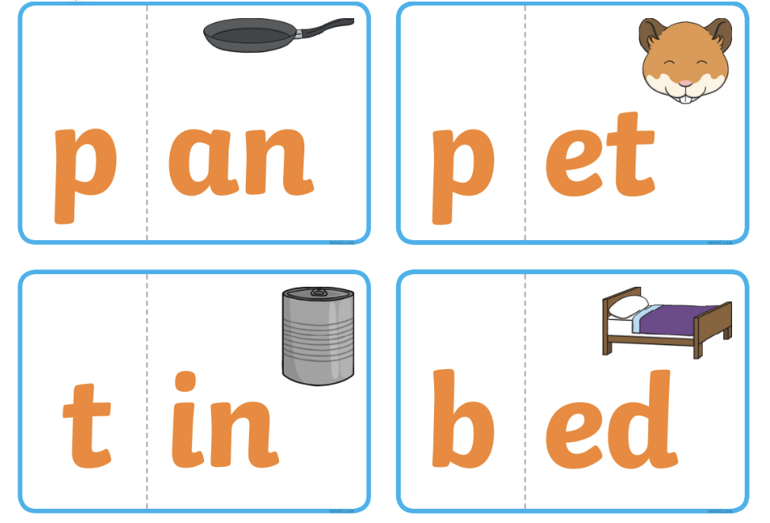
The Dyslexia Friendly Classroom: Useful Strategies to support learners with Spelling
Word Frames/ Elkonin Boxes -
Teach children to listen to the order of sounds in a word and represent these with a letter(s) in the correct sequence. Mapping these in the Word Frames/ Elkonin Boxes. Children can be supported by saying:
What is the first/ middle/ last sound that you hear? Do you know what letter can be used for that sound? In which box do you think it should be written?
Syllable Spelling - breaking words down into syllables to help spelling chunks of words. This can be helpful for spelling longer words. E.g help/ ful ro/ bot nap/ kin com/ pu/ ter
Onset and Rime - The onset is the first part of a single syllable word before a vowel. The rime is the part of the word including the vowel and the letter that follow.

Slide 16
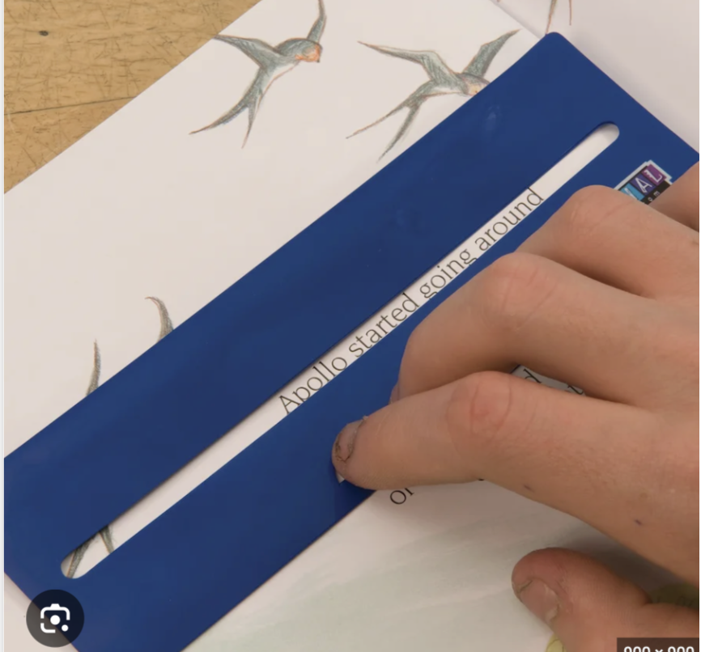
The Dyslexia Friendly Classroom: Useful Strategies to support learners with Reading
Enlarging text so that it is easier for children to read.
Placing information/ instructions from the board on the table - using a whiteboard.
Reducing the amount of text available at a time - text windows.
Use of reading rulers - to support with eye tracking.
Pre-teaching topic vocabulary and having these visually accessible supported with visual image where possible.
Not forcing children to read aloud - paired reading/ echo reading.
Use paint, playdough, paint brushes with water to write letters, glitter, sand, rice etc to make the shape of letters.

Slide 17
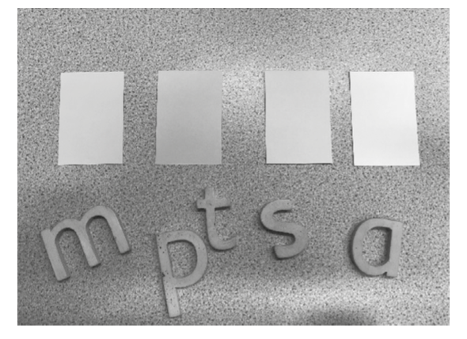
The Dyslexia Friendly Classroom: Useful Strategies to support learners with Reading
Segmenting and Blending
Teacher says the word. Learner touches the letters as they say the sounds. Learner blends the sounds back together. Teacher says the sounds. The learner blends the sounds together. The learner matches the word to a picture to demonstrate understanding.
Teacher says the word. The learner segments the word into sounds at the same time as identifying the correct letters.

Slide 18
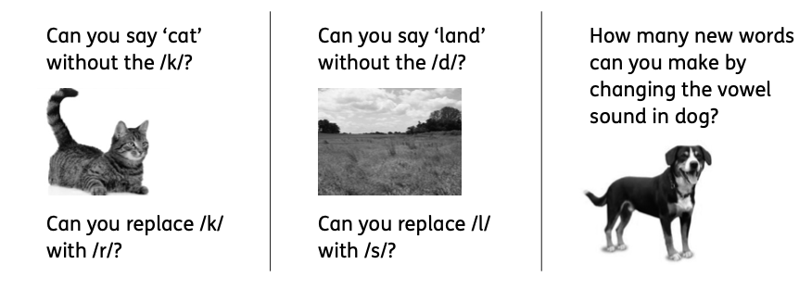
The Dyslexia Friendly Classroom: Useful Strategies to support learners with Reading
Make up silly sentences to help remember how to spell words:
SAID: Sally Ann Is Dancing BECAUSE: Big Elephants Can’t Add Up Sums Easily.
Phoneme Isolation and Manipulation

Slide 19
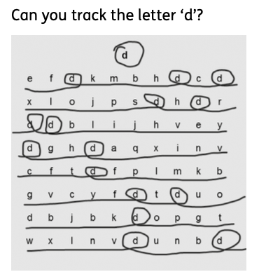
The Dyslexia Friendly Classroom: Useful Strategies to support learners with Reading
Tracking Activities

Slide 20
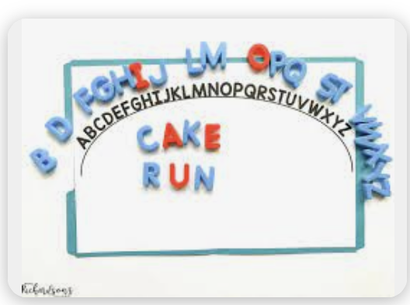
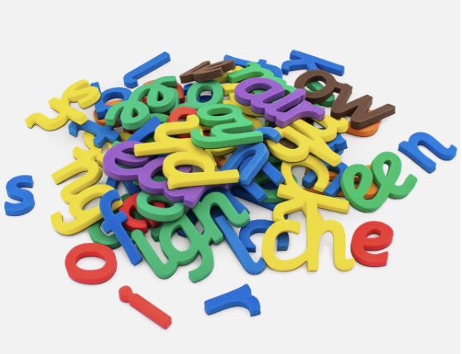
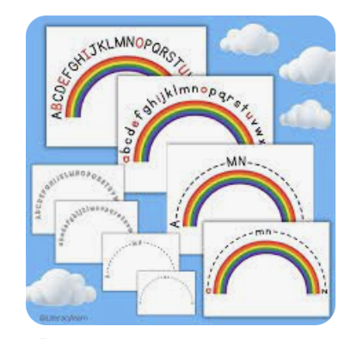
The Dyslexia Friendly Classroom: Useful Strategies to support learners with Reading
Alphabet Sequencing/ Alphabet Arc:
How many letters are there in the alphabet? Which letter is at the start/ end of the alphabet? Take turns to places letter in the alphabet.
Can you order the letters of the alphabet correctly in 2 minutes?
Alphabet speed up strategy. Place ‘a’ and ‘z’ in the correct places and then the middle two letters ‘m’ and ‘n’ in the correct places. Now order the rest of the letters in less than 2 minutes!
Without looking… What is the letter before/ after ..? (check)
Can you sort the letters into vowels and consonants?

Slide 21
Difference rather than a difficulty!
It is fundamental that individual differences are recognised and celebrated. We all have areas of strength and difficulties - our difficulties DO NOT define us!
All dyslexic learners will have a multitude of strengths disguised by their indifferences, which is likely to be accompanied by low self-esteem.

